Slide 1
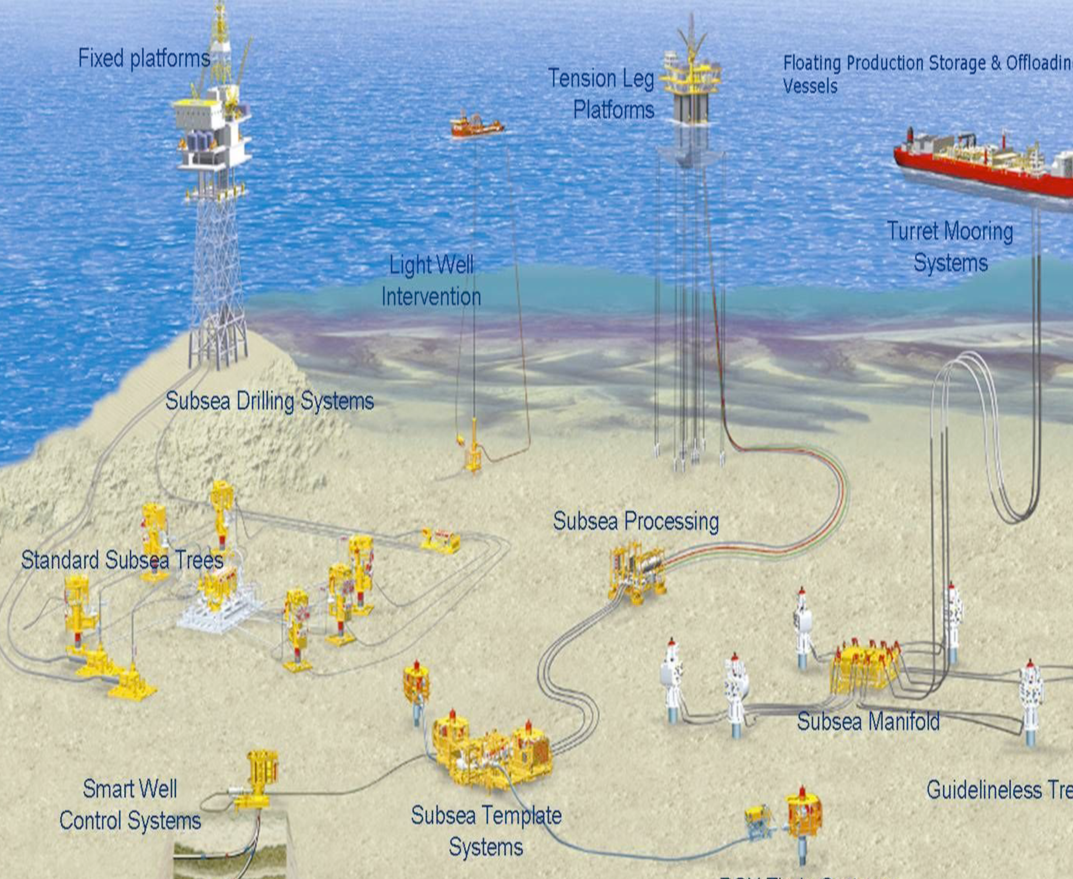
Slug flow in S-shaped risers
Studies on slug flow in S-risers: LedaFlow simulations and experiments
Mahnaz Esmaeilpour
Supervisor: Sigurd Skogestad
Co-supervisor: Esmaeil Jahansahi

Slide 2
Overview
1- Introduction
2- Experiments
3- LedaFlow Simulations
4- Comparing Simulations and Experiments

Slide 3
1. Introduction
Slug flow in S-shaped risers
4 different flow regimes
Stable flow Transitional flow (TTS)
Severe Slugging II Severe Slugging I (SSI)

Slide 4
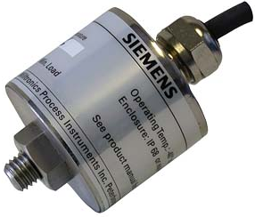

2. Experiments
Setup
Sensors
Pressure sensors Acoustic sensor

Slide 5
2. Experiments (contd)
Step change test in stable region
Series of tests with different Usl’s and Usg’s to make related flow regime map
Series of tests with different valve positions to make the bifurcation diagram

Slide 6
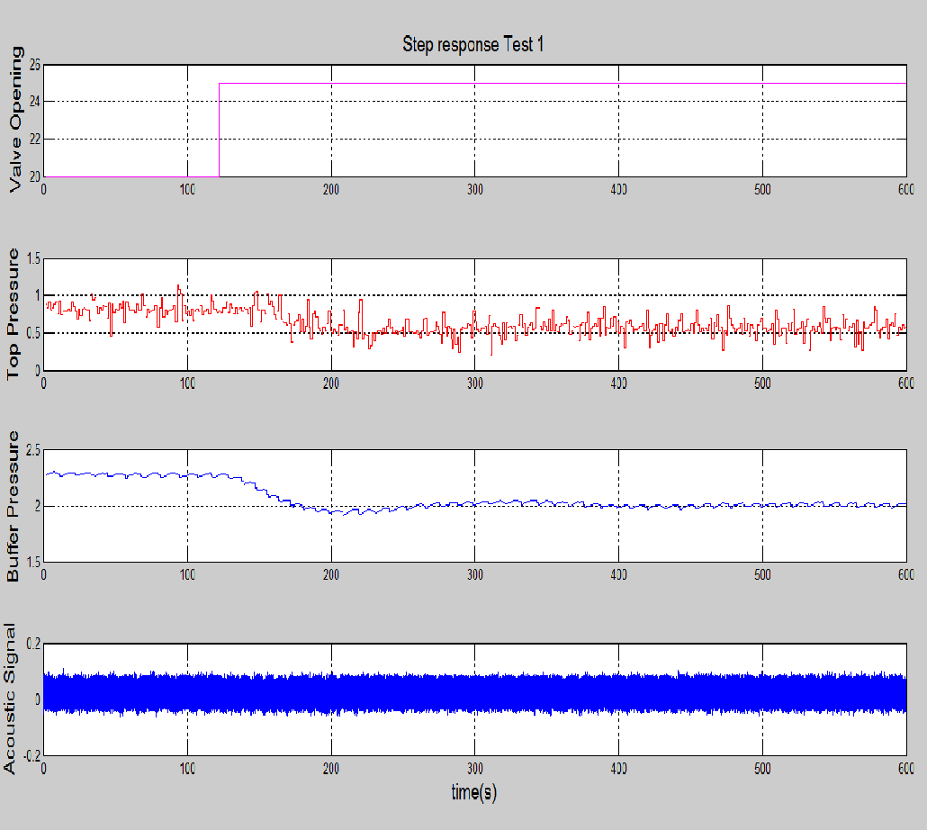
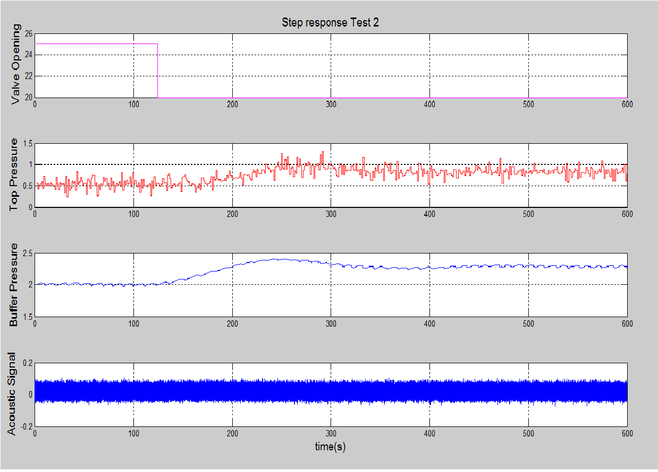
2. Experiments (contd)
Step change test in stable region
Usl = 0.2 [m/s] Usg = 1 [m/s]

Slide 7
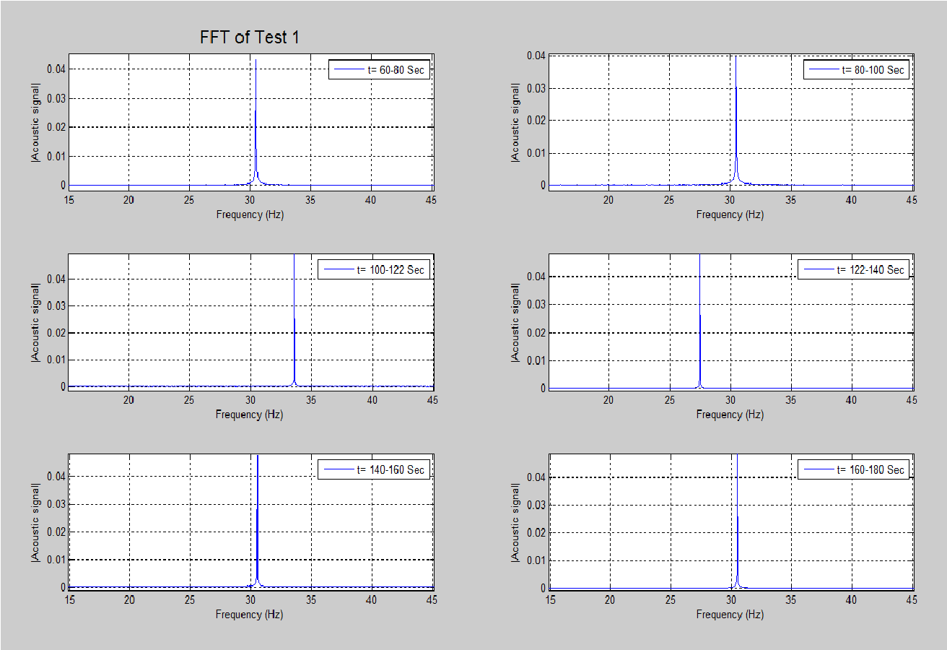
Step change test in stable region
FFT of acoustic signal
2. Experiments (contd)

Slide 8
2. Experiments (contd)
Flow regime map
70 points of different gas & liquid superficial velocities
Choke valve was fully open (100 % of valve opening)

Slide 9
2. Experiments (contd)
Bifurcation diagram
Usl= 0.2 [m/s] Usg= 1 [m/s]

Slide 10
3. Simulations
Simulating slug flow in S-riser with LedaFlow
Make the same flow regime map as experimental one
Making the same bifurcation diagram as experimental one by changing valve position in different simulations with a fixed Usl and Usg

Slide 11
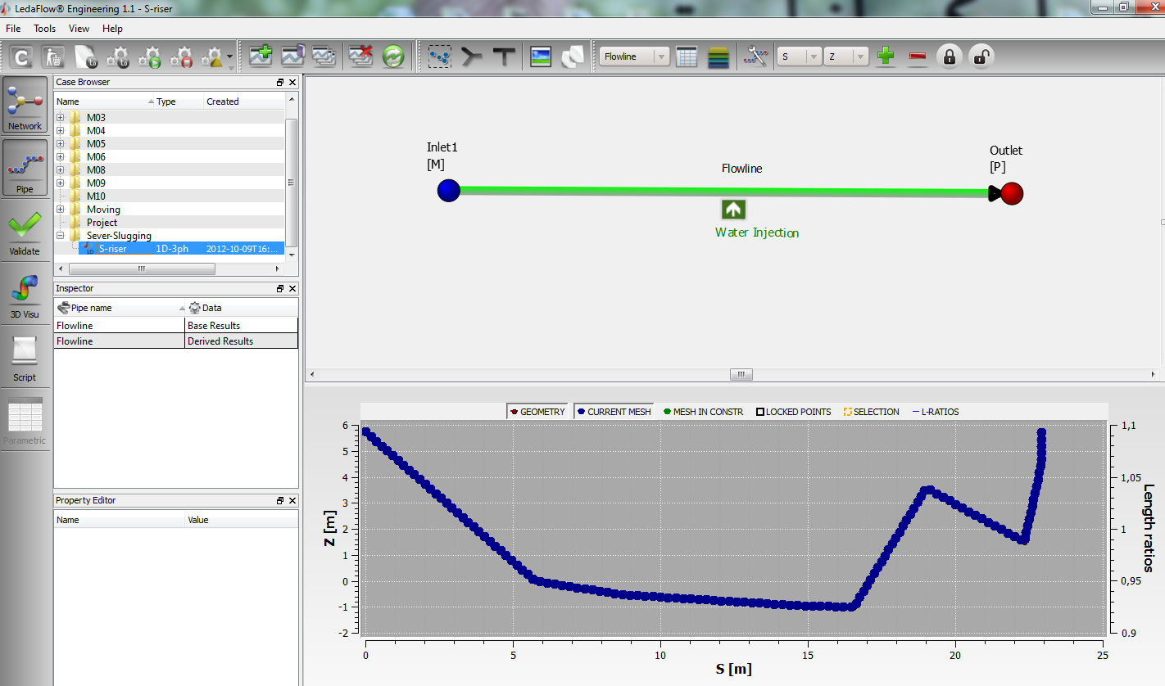
3. Simulations (contd)
Simulating slug flow in S-riser with LedaFlow

Slide 12
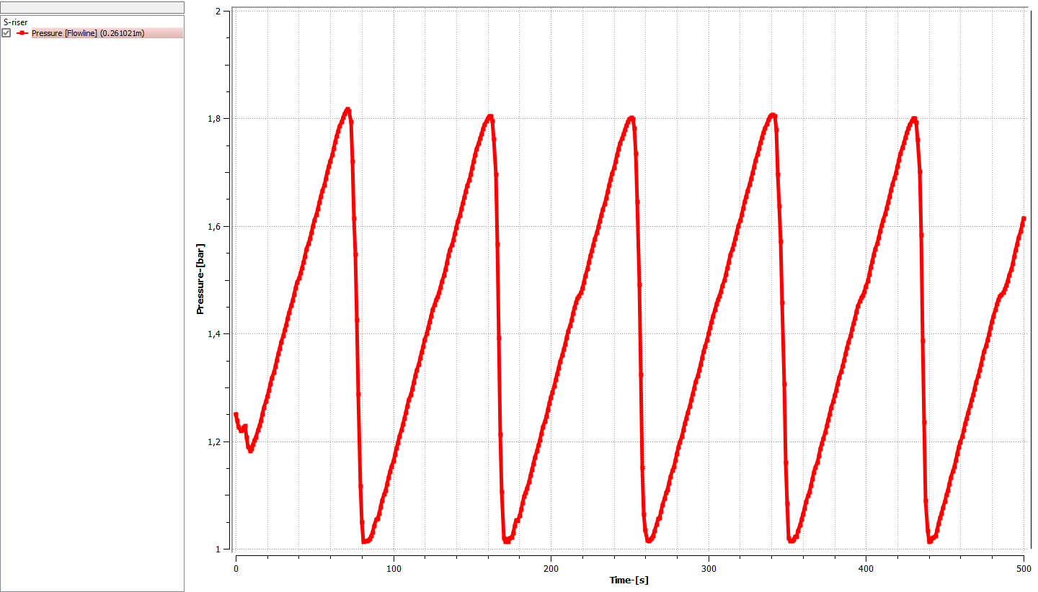
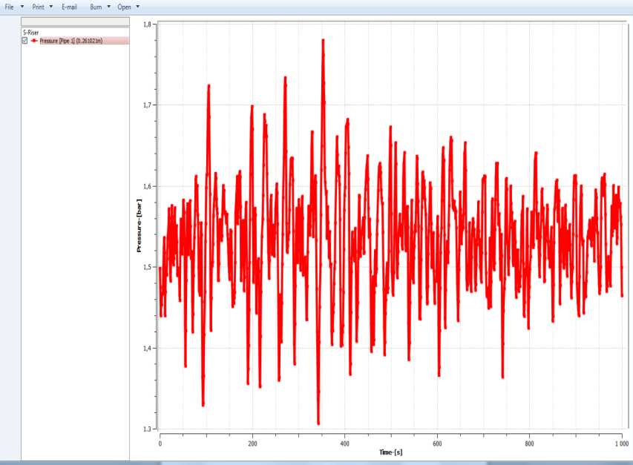
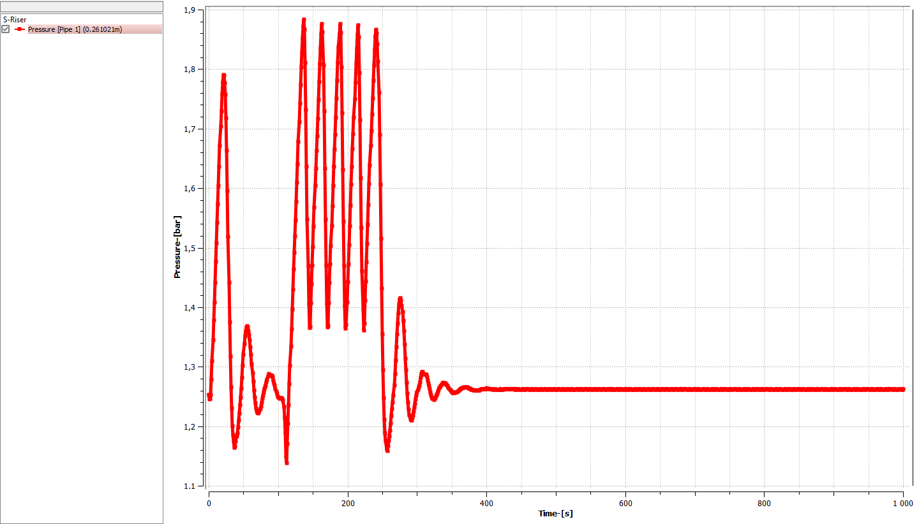
Severe Slugging I (SSI)
Usl=0.1 [m/s]
Usg= 1 [m/s]
3. Simulations (contd)
Transfer region (TTS)
Usl=0.1 [m/s]
Usg= 4 [m/s]
Stable region
Usl=0.2 [m/s]
Usg=19 [m/s]

Slide 13
Flow regime map based on LedaFlow simulations
3. Simulations (contd)

Slide 14
Bifurcation diagram
3. Simulations (contd)
Usl= 0.2 [m/s] Usg= 1 [m/s]

Slide 15
4. Comparing simulations & experiments

Slide 16
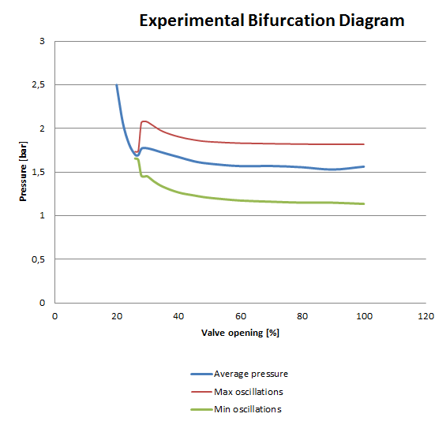
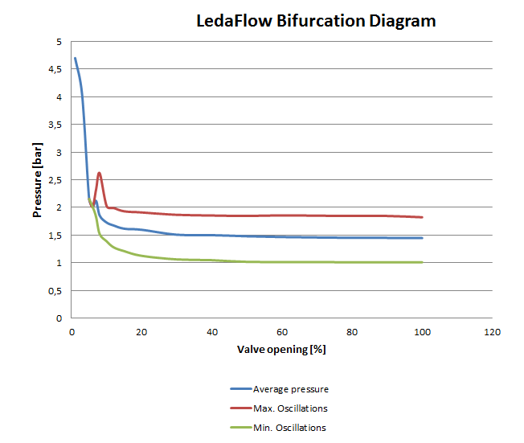
4. Comparing simulations & experiments (contd)

Slide 17
Thank you!

