Slide 1
Modeling and control of steam bottoming cycles with moving point of vaporization
William Davidsen
Supervisor: Sigurd Skogestad
Co-supervisor: Lucas F. Bernardino

Slide 2
Introduction
Gas turbines
Petroleum sector:
11.6 million tons CO2eq (2023)
Several GHG reducing measures:
Electrification
Gas turbine efficiency improvement
Scope:
Develop a bottoming cycle model with moving point of vaporization to study performance and operational strategies for offshore implementations
Total CO2 Emissions
82.9%
24.8%
Petroleum related emissions

Slide 3
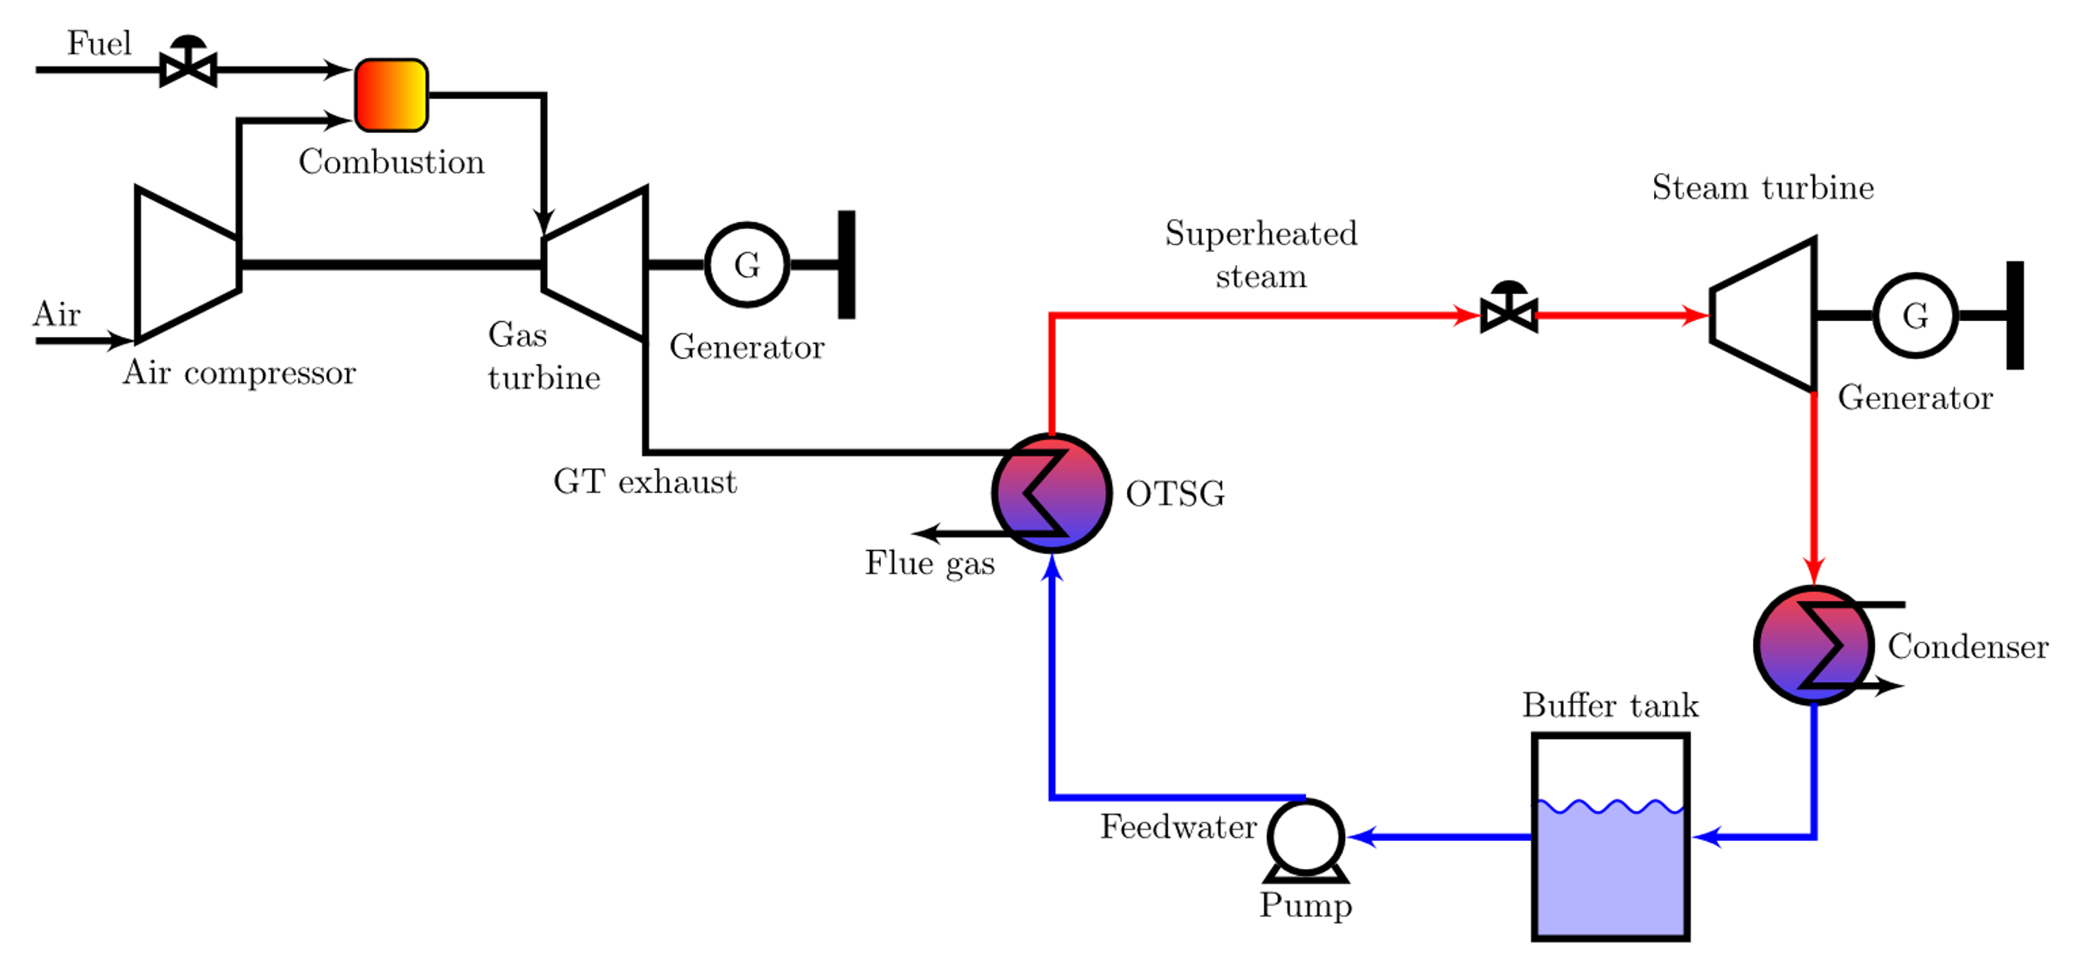
Process description
Focus on bottoming cycle
Boundary conditions
Simplifying assumptions:
Ideal gas, constant Cp, homogeneous flow,
pressure driven flow
Component framework in Tikz for flowsheets developed by Zotică et al. (2022)

Slide 4
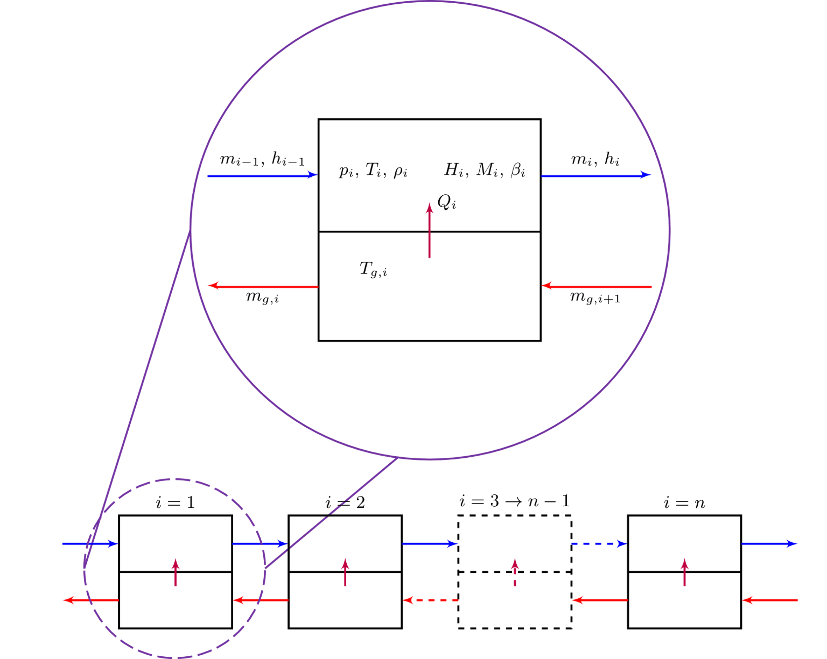
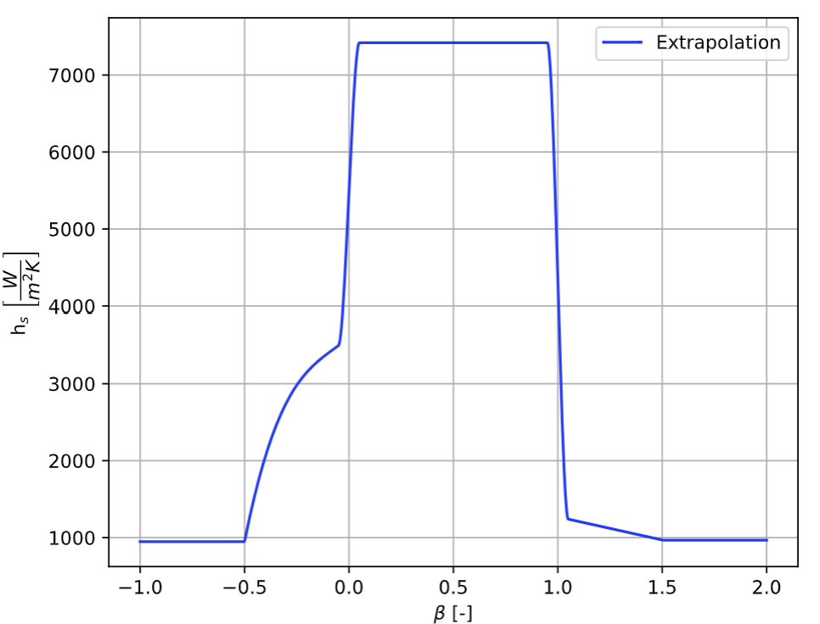
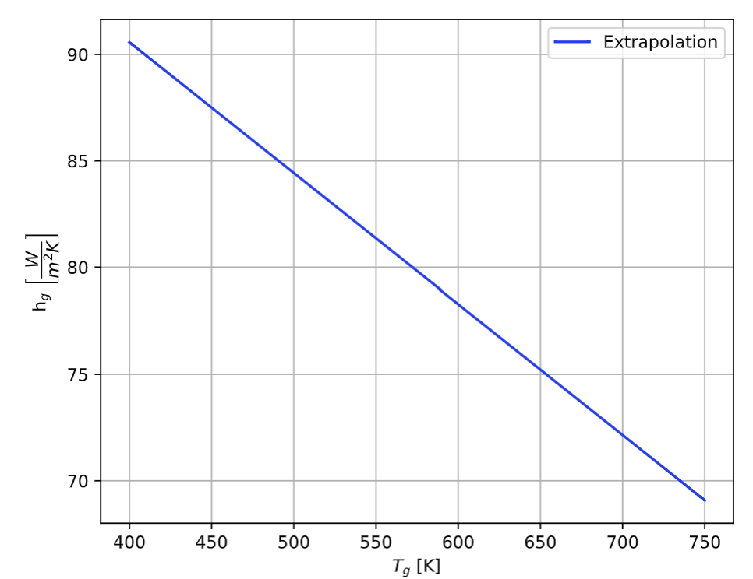
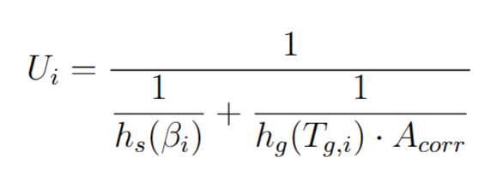
Model formulation
Continuation of OTSG model developed in specialization project.
Revisions to the developed model:
Change in temperature driving force
Change in calculation of overall heat transfer coefficient U

Slide 5
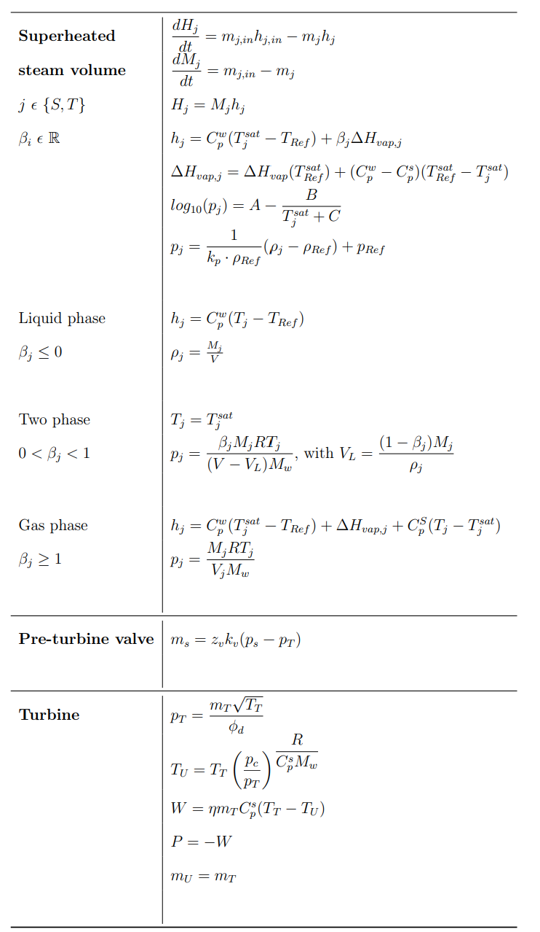
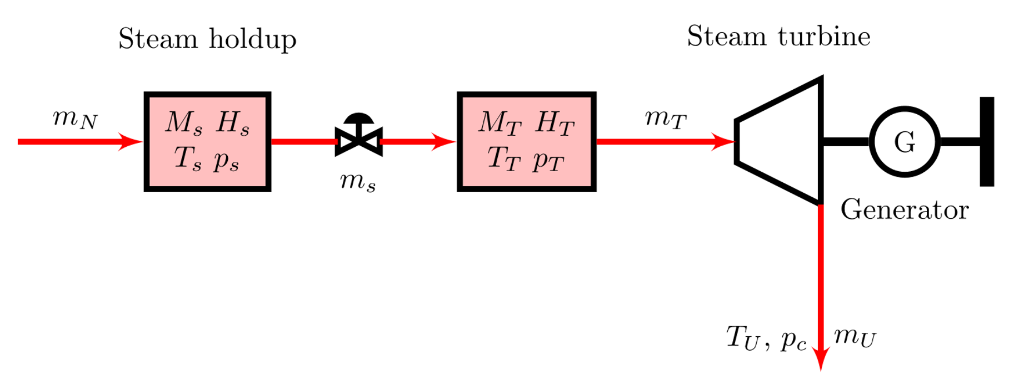
Model formulation
Steam section
Units: Steam holdups, steam valve and steam turbine
Assumptions: Isentropic expansion, polytropic efficiency, linear valve characteristics

Slide 6
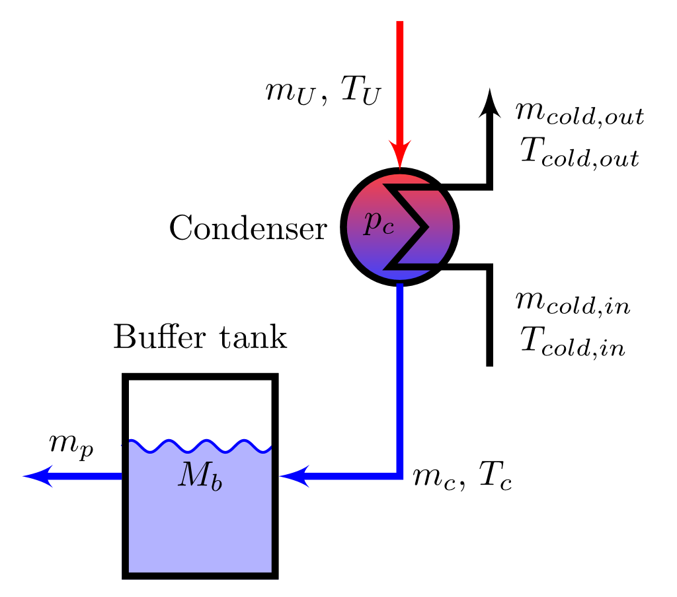
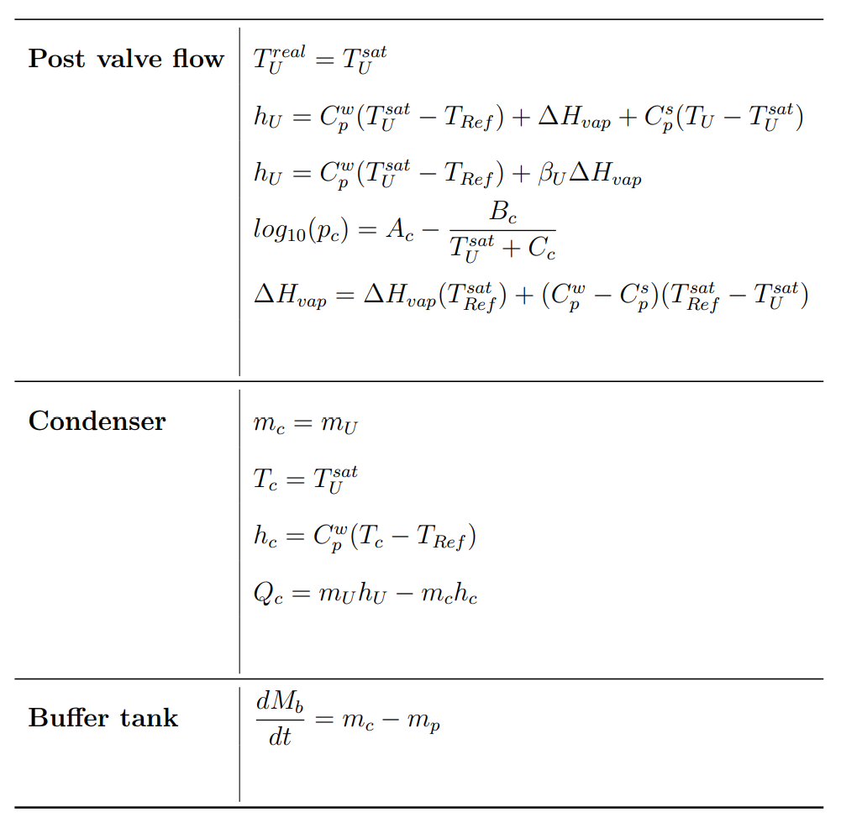
Model formulation
Condenser: One hot side volume, static mass and energy balances, constant condenser pressure, two-phase inflow and saturated liquid outflow
Buffer tank: Dynamic mass balance, no heat transfer

Slide 7
Model implementation
Implementation: CasADi/MATLAB
DAE Initial value problem
$$\dot{x}=f(x,z,t)$$
$$0=g(x,z,t)$$
Solver: IDAS from SUNDIALS using dense, direct newton iteration
Switching logic developed in specialization project extended
Used vapor quality to detect phase change
Cond 1: $β≥1$, Cond 2: $β≤0$
Nested CasADi if_else to change equation in solver
If_else(Cond 1, Gas, if_else(Cond 2, Liquid, Two-phase))

Slide 8
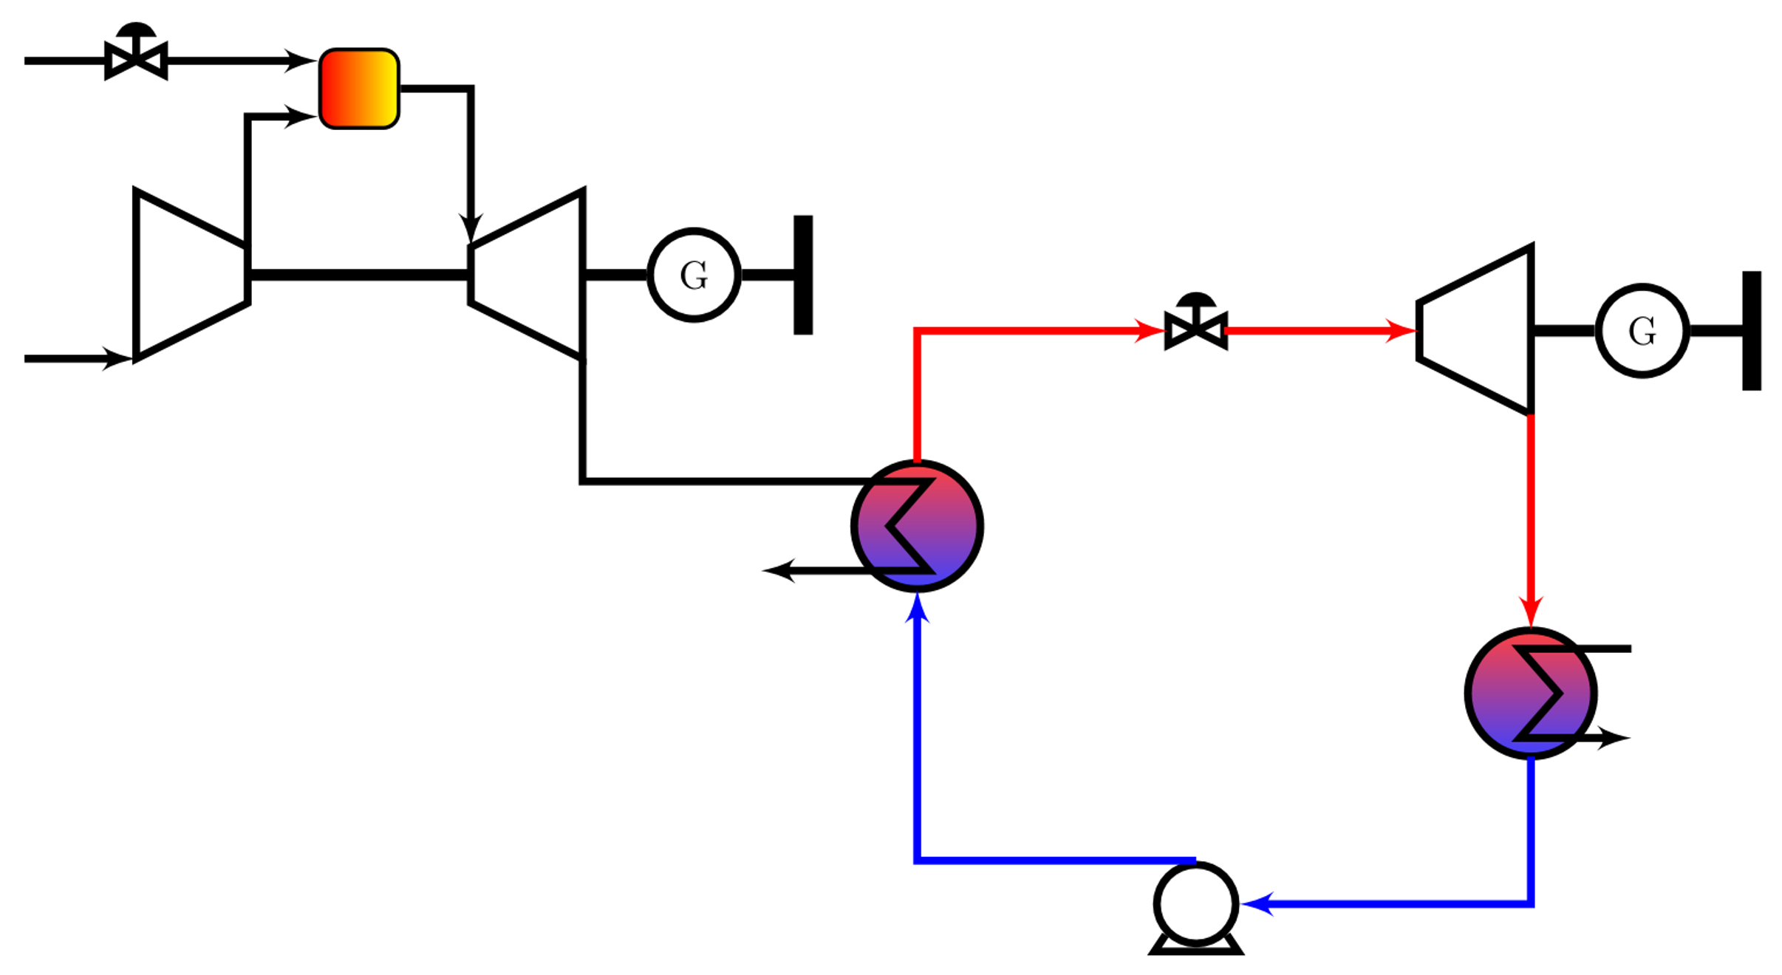
Control structures
MV | CV | DV
$z_{v}$ - Steam valve | $T_{s}$ - Steam temperature | $T_{p}$ - Pump temperature
$z_{m}$ - Pump valve | $p_{s}$ - Steam pressure | $T_{g}^{0}$ - Flue gas temperature
$m_{cold, in}$ - Condenser cold side mass flow | $p_{c}$ - Condenser pressure | $m_{g}^{0}$ - Flue gas mass flow
 | $W$ – Steam turbine work
Bottoming cycle
3 manipulated variables
4 available controlled variables
$m_{g}^{0}$ treated as an extra MV in some cases paired with $W$ for power control
Assumed constant $p_{c}$by perfect control of $m_{cold, in}$
$$z_{v}$$
$$W$$
$$T_{s} p_{s}$$
$$m_{g}^{0} T_{g}^{0}$$
$$m_{cold,in}$$
$$p_{c}$$
$$T_{p}$$
$$z_{m}$$

Slide 9
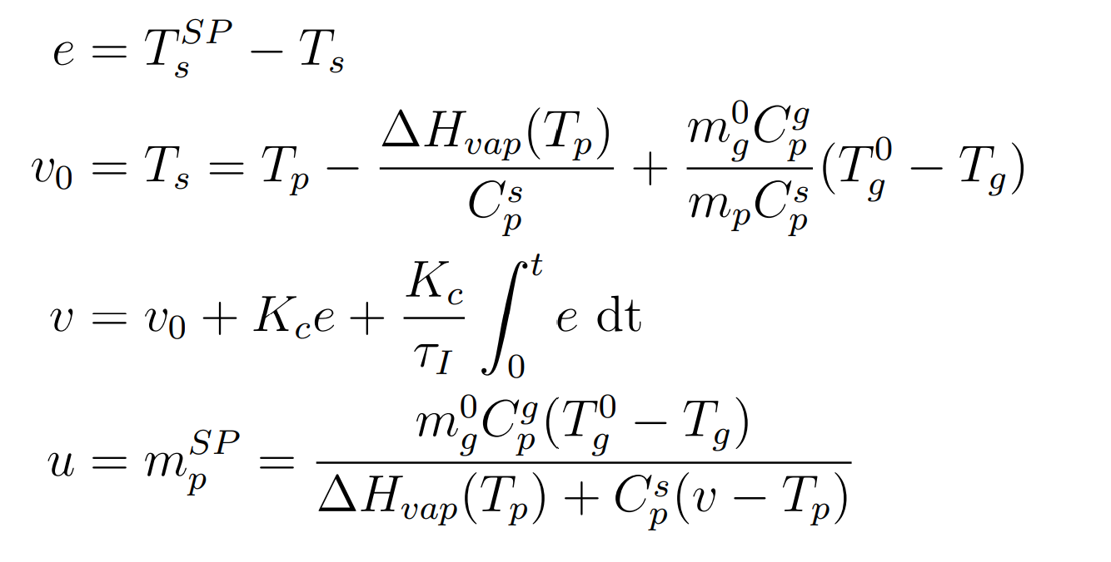
Control structures
Flow controller ($z_{m}−m_{p}$)
Inner loop for temperature controller
I-Controller, $τ_{c}=5s$
Steam pressure controller ($z_{v}−p_{s}$)
PI-Controller + Anti-windup, $τ_{c}=5s$
Steam temperature controller ($m_{p}^{SP}−T_{s}$)
Comparison of feedforward and feedback
Feedforward developed by Zotică et al. (2022), but derived for $T_{s}$ instead of $h_{s}$
PI-Controller, $τ_{c}=100s$
Feedback
Feedforward
Combined
Cristina Zotică et al. “Control of steam bottoming cycles using nonlinear input and output transformations for feedforward disturbance rejection. url: https://www.sciencedirect.com/science/article/pii/ S2405896322009764.

Slide 10
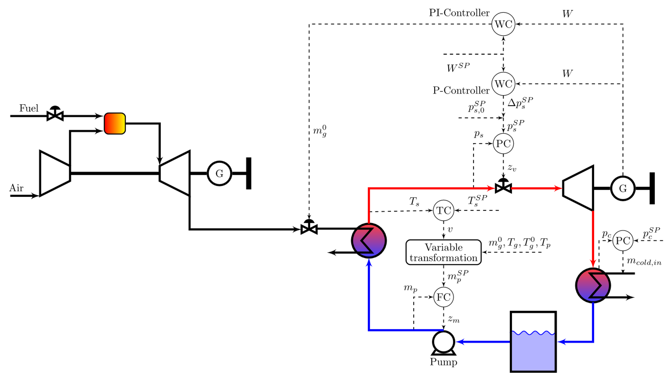
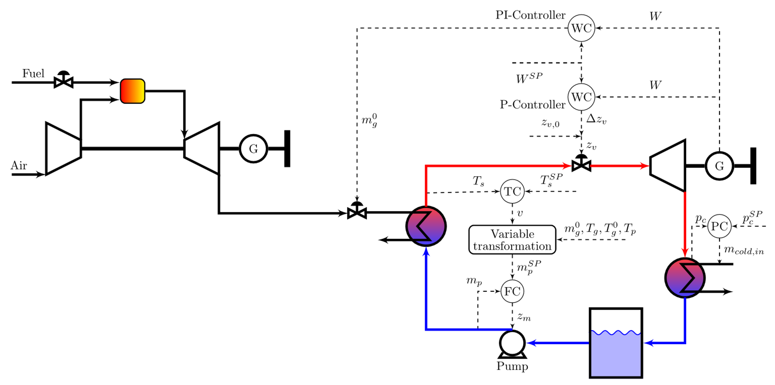
Control structures
Case study on power control
Steam cycle case & combined cycle case
Steam cycle case -> Maintain $W^{SP}$
$m_{g}^{0}$ extra MV (more equal to coal-fired plant)
Parallel controller (MISO) for $W$ as developed in Zotică et al. (2020)
Two configurations: constant and floating pressure
Constant pressure:
PI: $τ_{c}=80s$ P: $τ_{c}=20s$
Floating pressure:
PI: $τ_{c}=40s$ P: $τ_{c}=5s$
Constant pressure case
Floating pressure case
Cristina Zotică et al. “Optimal operation and control of heat to power cycles: A new perspective from a systematic plantwide control approach. url: https: //www.sciencedirect.com/science/article/pii/S0098135419311342.

Slide 11
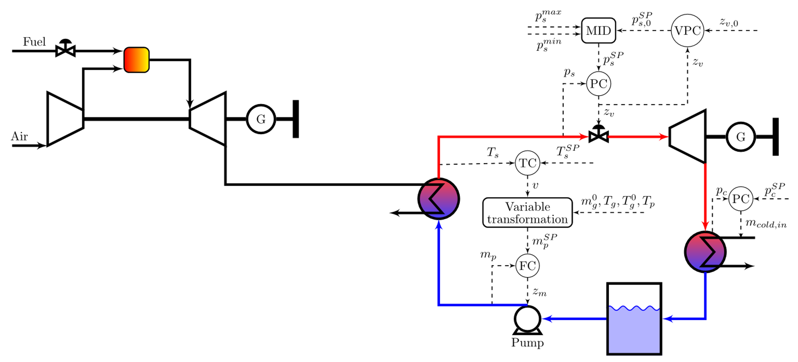
Control structures
Combined cycle case -> maximize $W$
Valve position controller
PI-Controller + Anti-windup, $τ_{c}=200s$
Dynamically constant pressure, steady state minimize throttling losses
Additional pressure constraints

Slide 12
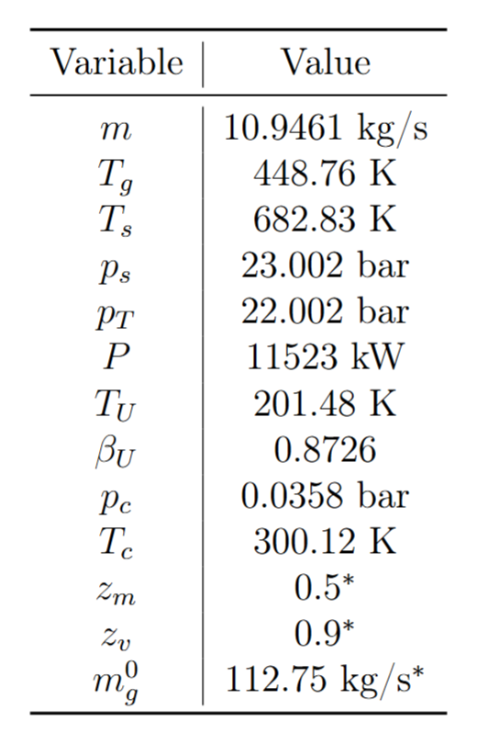
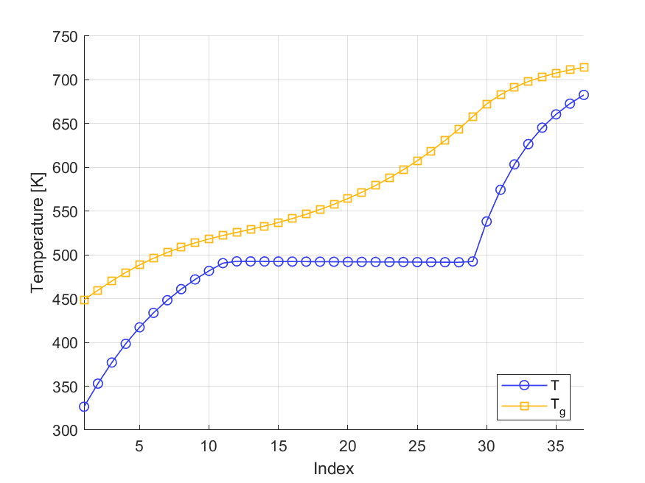
Simulations
Inlet conditions from Montañés et al. (2024)
->Corresponds to 90% GT load
Open-loop steady state
$T_{s}$ ca. 50K higher and $T_{g}$ ca. 6K higher than reference
Estimations of $C_{p}$ values
$m$ somewhat smaller than design (10.95 kg/s)
Estimations of $φ_{d}$
Rubén M. Montañés, Cristina Zotică, and Adriana Reyes-Lúa. “Operation and control of compact offshore combined cycles for power generation url: https://www.sciencedirect.com/ science/article/pii/S0360544224000860.

Slide 13
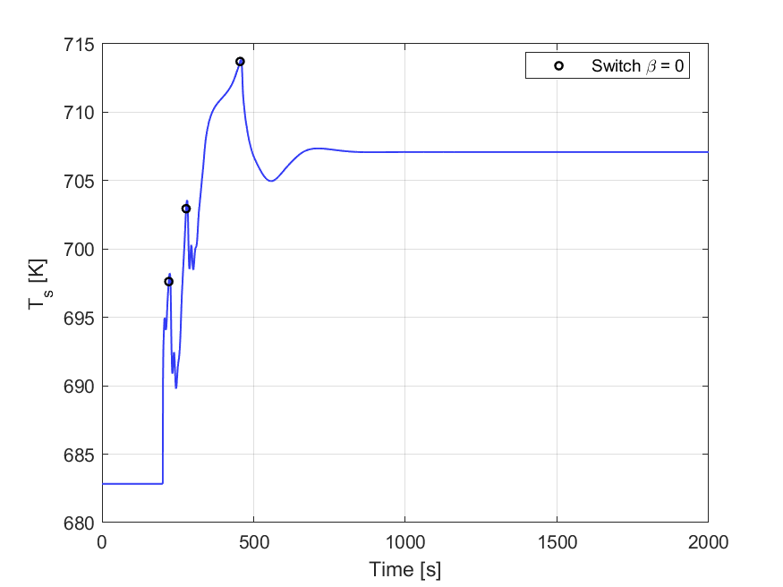
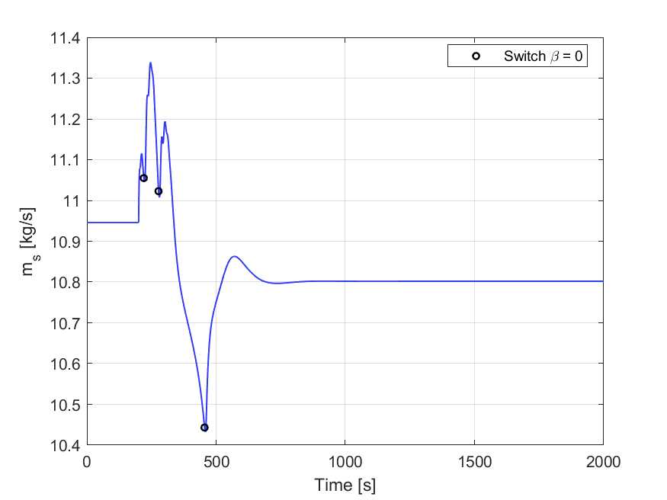
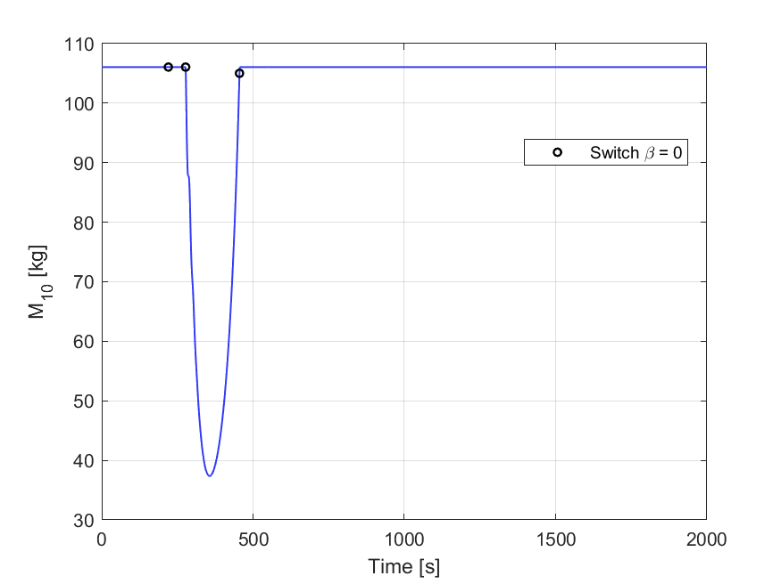
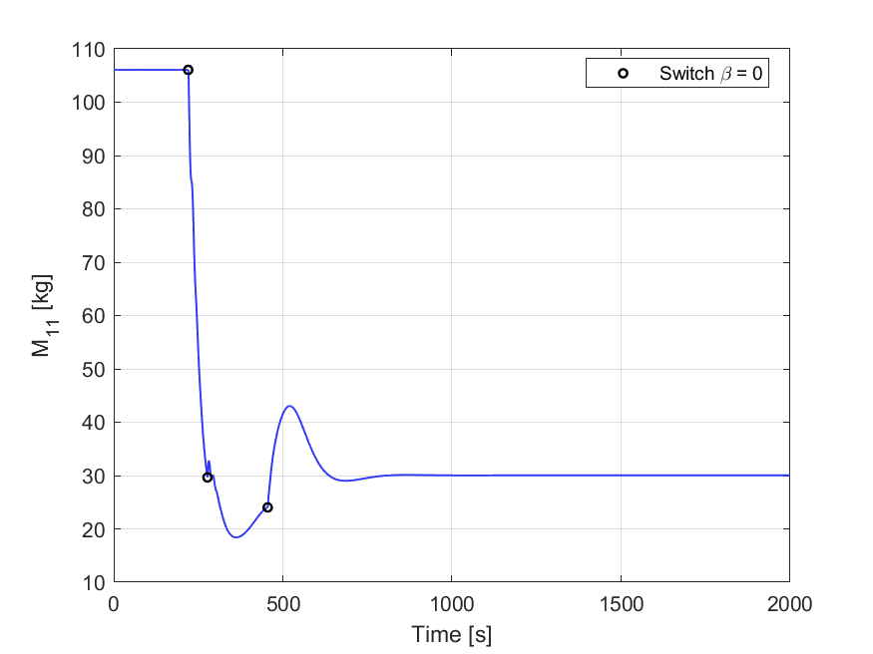
Open-loop Simulations
Disturbance: +10K flue gas temperature
Open loop response heavily influenced by switching dynamics

Slide 14
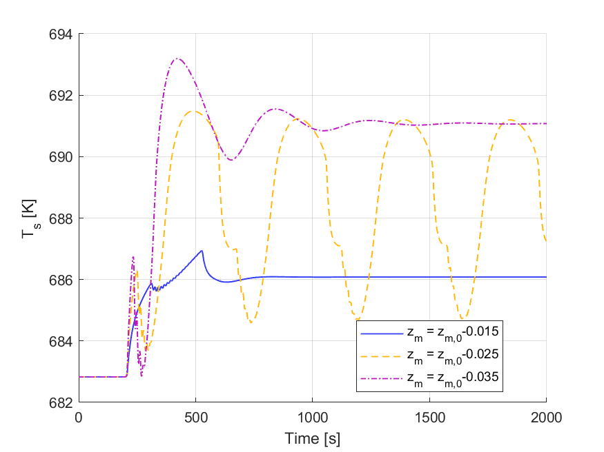
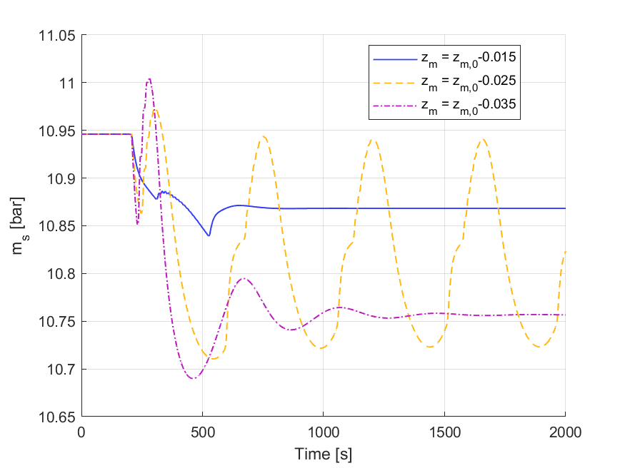
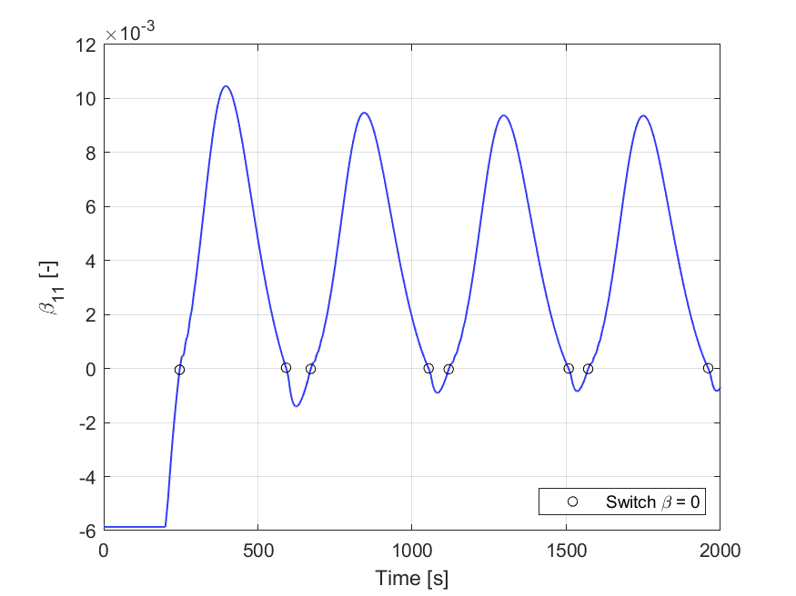
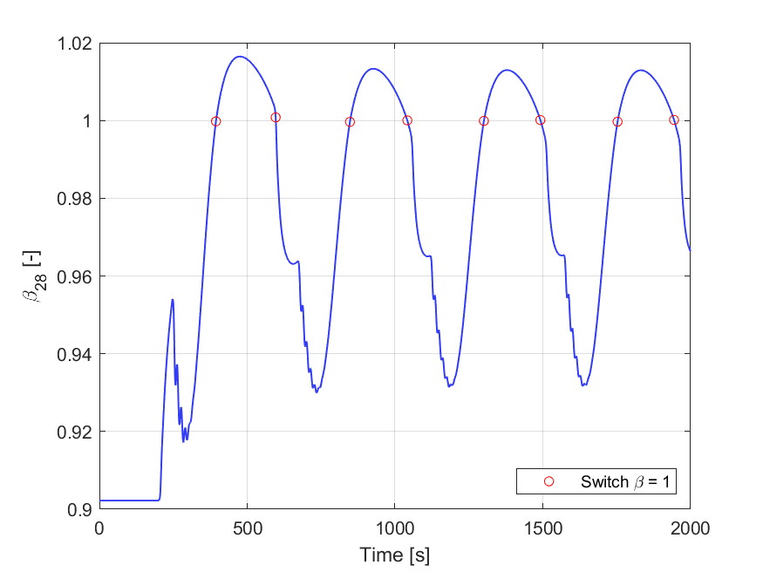
Open-loop Simulations
Sustained oscillations at specific states of the open-loop system
One common factor: $β=0^{+}$
Reproduced for N = 25, 55
Not numeric, likely related for simple fluid model
Not seen for only OTSG or turbine
Floating steam pressure
Long period (~500s)
Solution: Flow controller

Slide 15
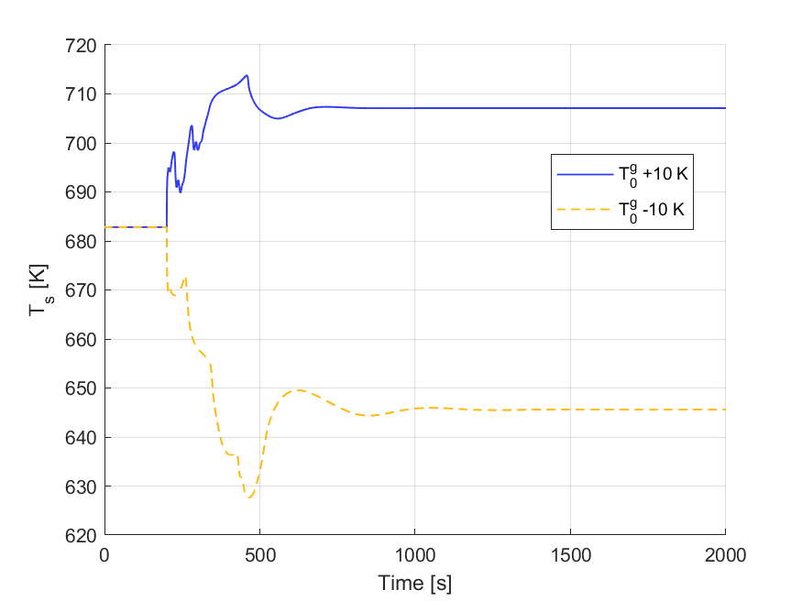
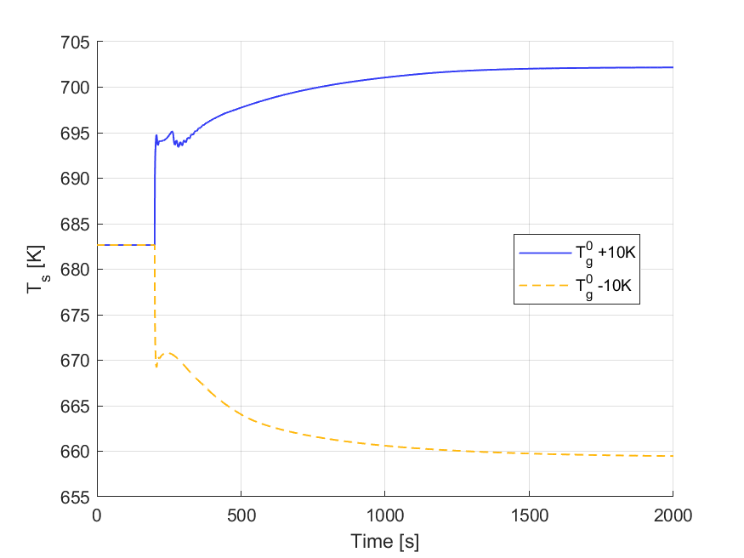
Flow controller
Open-loop response was nonlinear
Here seen for $T_{g}^{0}±10K$
Open-loop: 50% larger change for negative step
Flow controller: 20% larger change for negative step
Improved dynamic temperature response

Slide 16
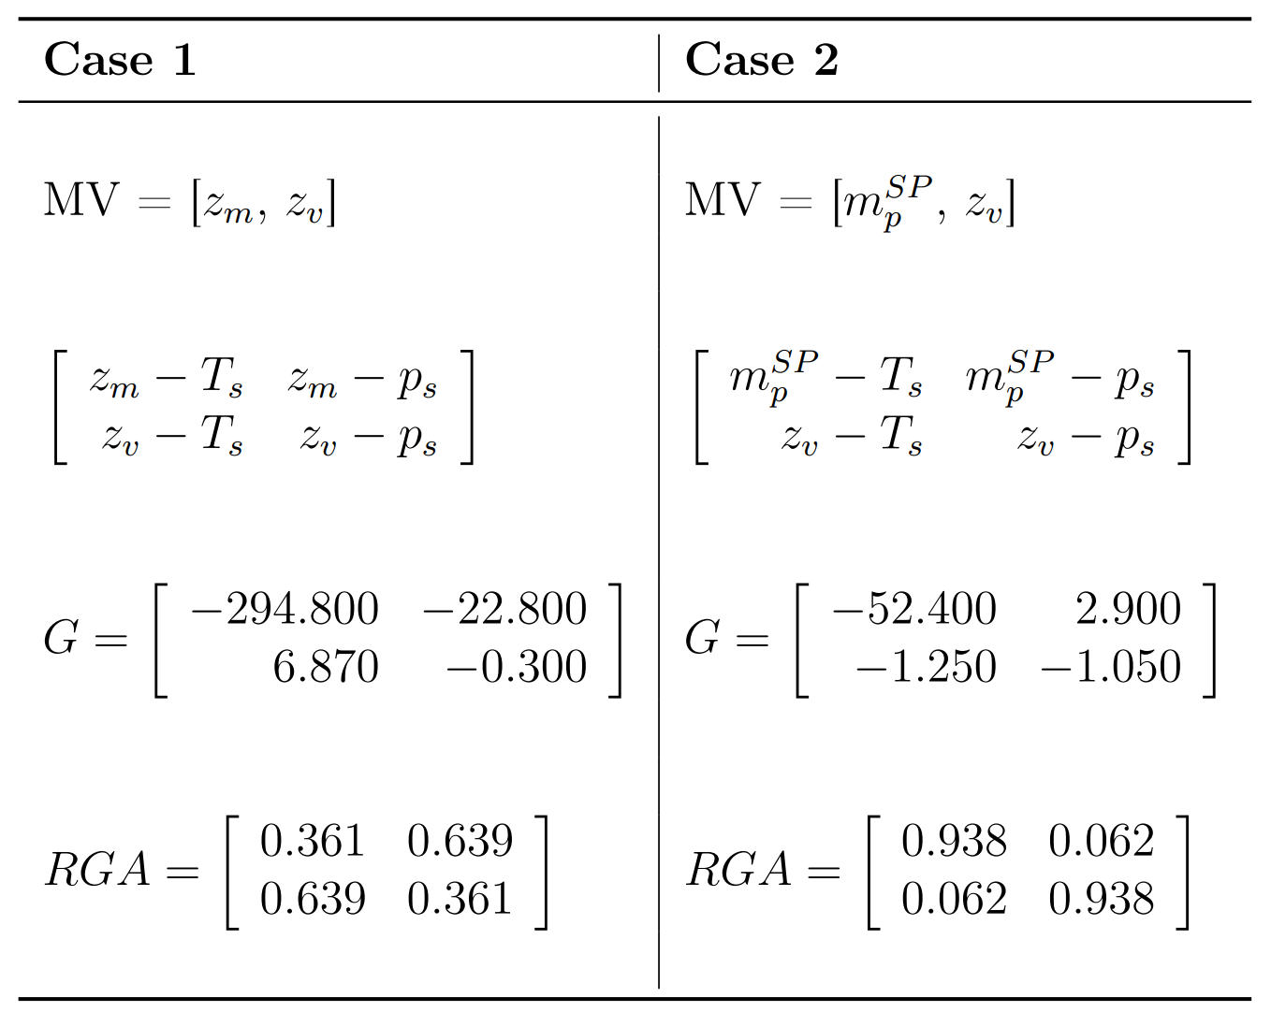
Flow controller
Steady state RGA -> study change in interactions from flow controller implementation
Case 1 (No flow controller)
Both pairings possible, but off-diagonal closer to identity
Case 2 (Flow controller)
Diagonal pairing only viable
Temperature and pressure more decoupled
Several arguments for flow controller: remove oscillations, reduce nonlinear behavior, improve dynamic response and decouple controlled variables

Slide 17
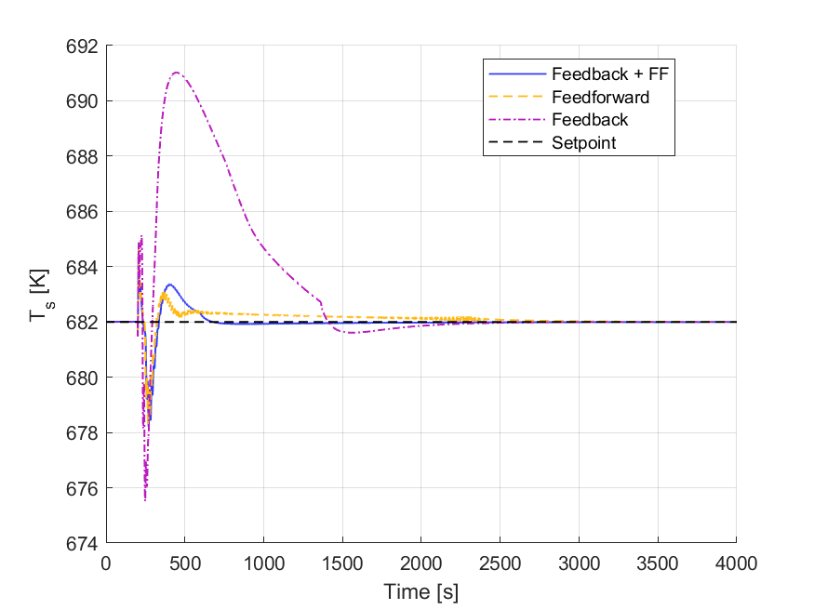
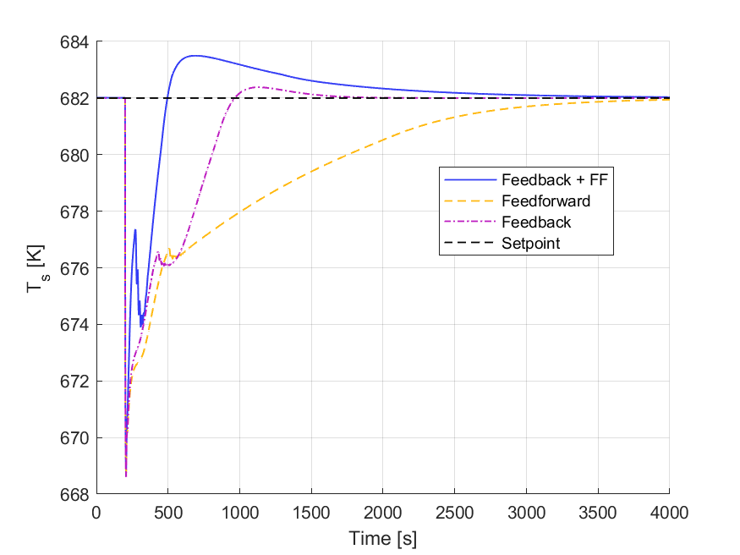
Temperature controller comparison
Floating pressure mode
Feedforward had better prediction for disturbances in $m_{g}^{0}$
Combined generally smallest deviation from setpoint
Same preferred controller as in Zotică et al. (2022)
+10% step in $m_{g}^{0}$
-10K step in $T_{g}^{0}$
Feedback
Feedforward
Combined
Cristina Zotică et al. “Control of steam bottoming cycles using nonlinear input and output transformations for feedforward disturbance rejection. url: https://www.sciencedirect.com/science/article/pii/ S2405896322009764.

Slide 18
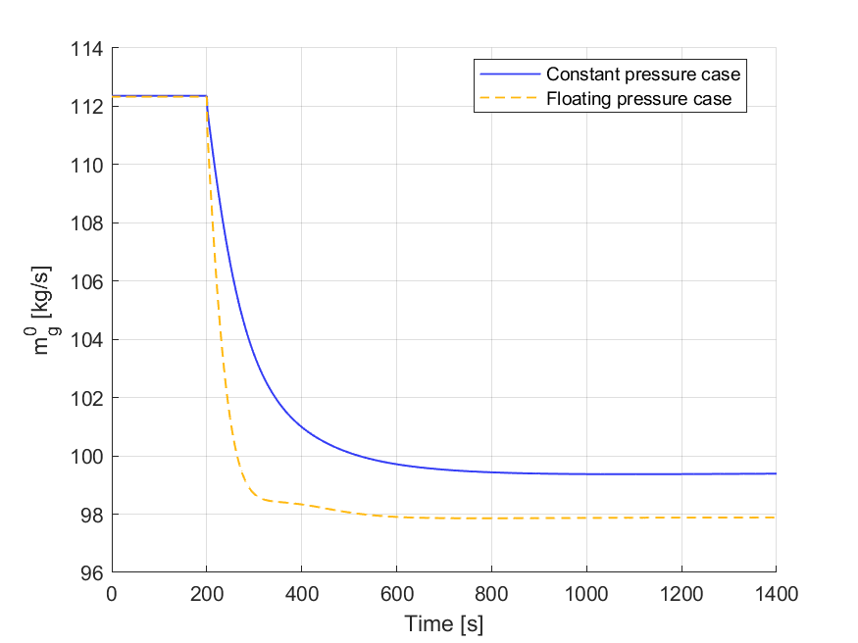
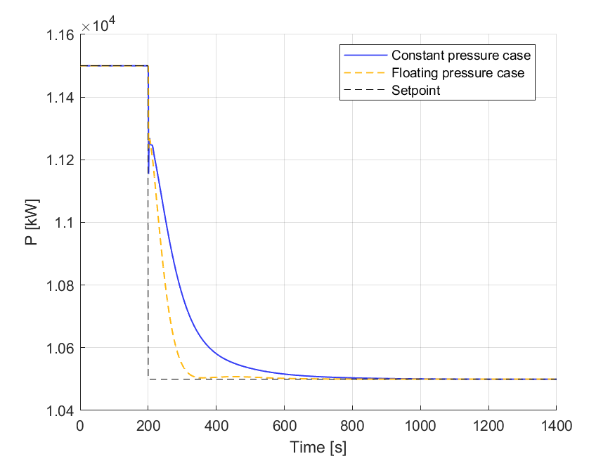
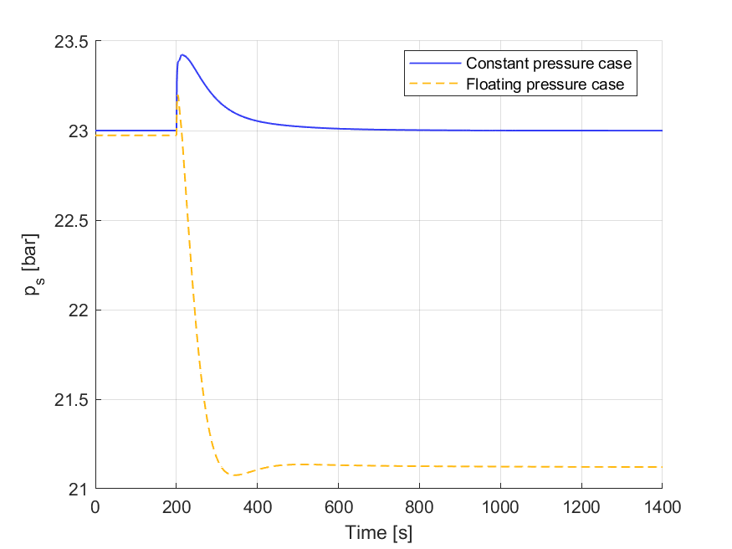
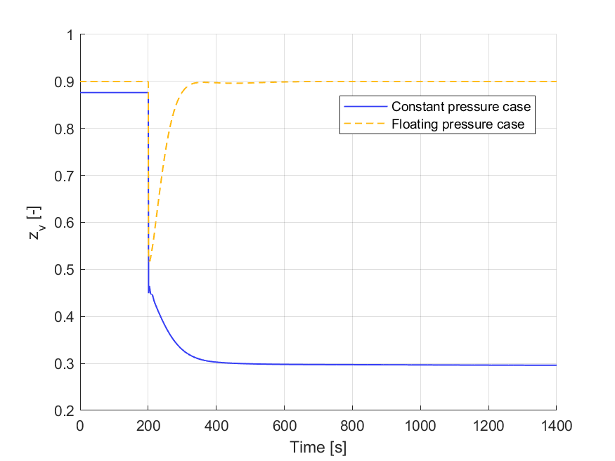
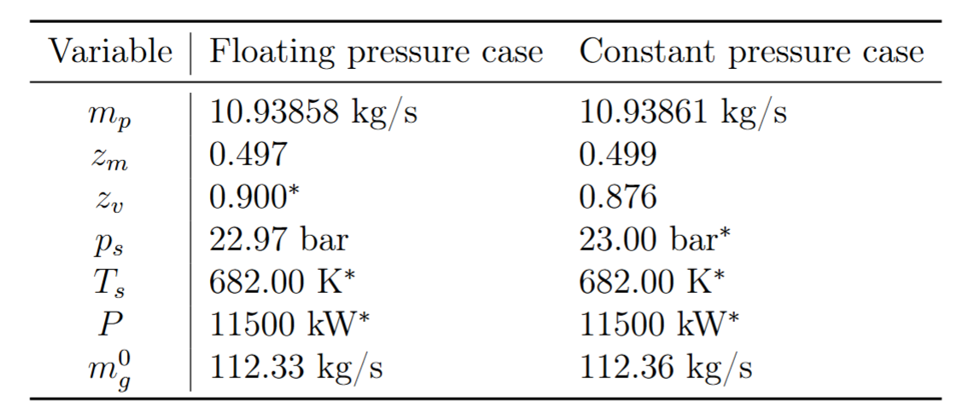
Case study on power control steam cycle case
Differences in steady-state
Setpoint change in power
Larger throttling loss as lower loads
Floating case faster due to smaller $τ_{c}$
Could have been tuned more aggressively for better setpoint tracking

Slide 19
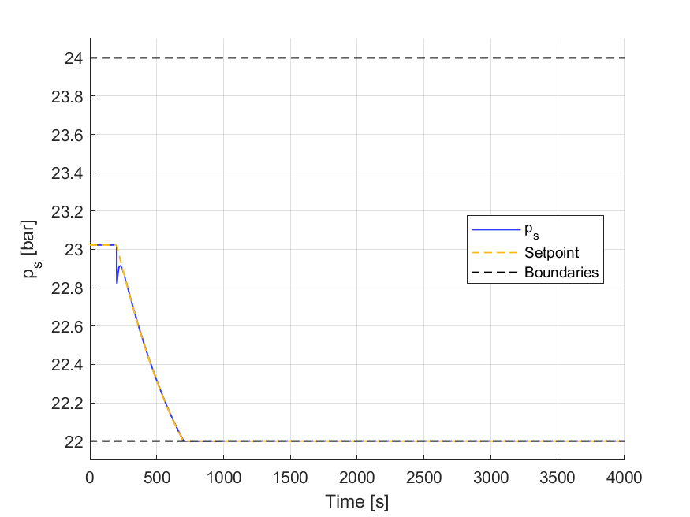
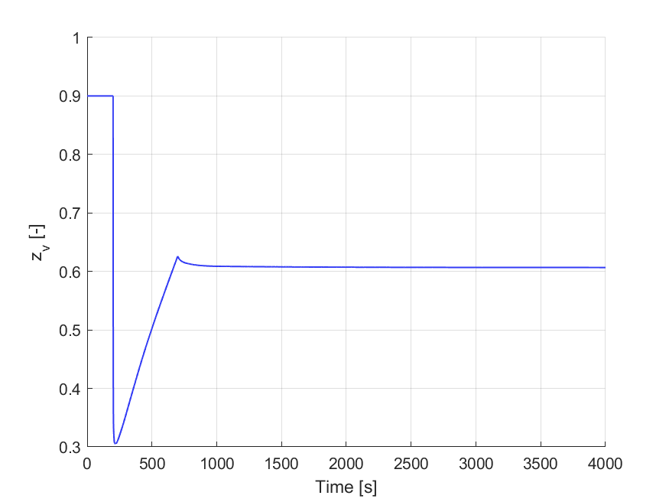
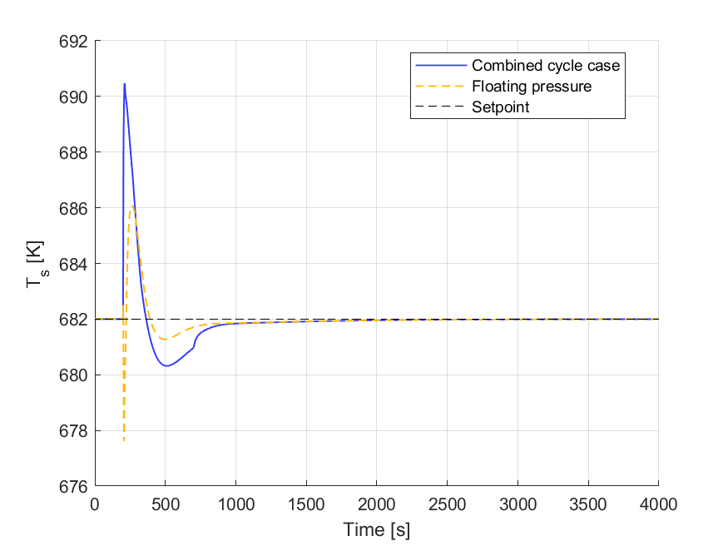
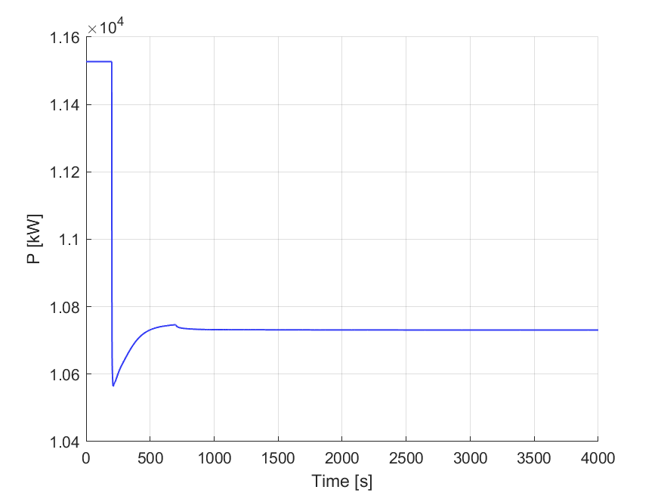
Case study on power control Combined cycle case
VPC change pressure setpoint to open valve
Lower pressure constraint activated
Improved steam temperature dynamics from constant pressure not observed as found in Montañés et al. (2024)
Modeling: No thermal inertia in OTSG tube wall, no enthalpy pressure dependence
Tuning differences
Rubén M. Montañés, Cristina Zotică, and Adriana Reyes-Lúa. “Operation and control of compact offshore combined cycles for power generation url: https://www.sciencedirect.com/ science/article/pii/S0360544224000860.

Slide 20
Additional discussion
Assumptions may be improved, but not expected to change overall approximation of model
Fluid acceleration
OTSG tube wall thermal inertia and steam volume size
Dynamics dependent on OTSG resolution
Code organization and solver
Major improvements from building DAE once instead of each time step
No improvement from using other solver methods such as sparse newton or preconditioned Krylov

Slide 21
Conclusion
Dynamic model of steam bottoming cycle with moving point of vaporization was built
Simulations showed nonlinearities and instabilities of open-loop model
Introduction of flow controller was beneficial for linearization and improved dynamic response
Confirmed advantages of combined feedback and feedforward control of steam temperature seen in other studies
For combined cycle case, the VPC reduced steady state throttling losses, but improved steam temperature dynamics was not observed
For steam cycle case, no need for constant pressure operation, could have been tuned more aggressively

Slide 22
References
Rubén M. Montañés, Cristina Zotică, and Adriana Reyes-Lúa. “Operation and control of compact offshore combined cycles for power generation”. In: Energy 290 (2024), p. 130315. issn: 0360-5442. doi: https://doi.org/10. 1016/j.energy.2024.130315. url: https://www.sciencedirect.com/ science/article/pii/S0360544224000860.
Cristina Zotică et al. “Control of steam bottoming cycles using nonlinear input and output transformations for feedforward disturbance rejection”. In: IFAC-PapersOnLine 55.7 (2022). 13th IFAC Symposium on Dynamics and Control of Process Systems, including Biosystems DYCOPS 2022, pp. 969– 974. issn: 2405-8963. doi: https://doi.org/10.1016/j.ifacol.2022. 07.570. url: https://www.sciencedirect.com/science/article/pii/ S2405896322009764.
Cristina Zotică et al. “Optimal operation and control of heat to power cycles: A new perspective from a systematic plantwide control approach”. In: Computers & Chemical Engineering 141 (2020), p. 106995. issn: 0098-1354. doi: https://doi.org/10.1016/j.compchemeng.2020.106995. url: https: //www.sciencedirect.com/science/article/pii/S0098135419311342.

