Slide 1
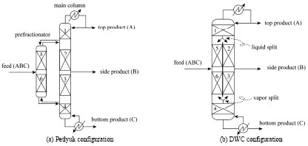
Dividing wall column application
in heterogeneous azeotropic distillation
(In collaboration with PERSTORP, SWEDEN)
Supervisor: Sigurd Skogestad
Student : LE Quang Khoa

Slide 2
INTRODUCTION
Dividing wall column is an application of thermally coupled Petlyuk column arrangement. This technology allows a significant energy reduction for separation of multicomponent.
Heterogeneous azeotropic distillation is used in industry to separate close boiling point mixture and azeotropes.
The system: Cyclohexanone, Water, Acetic Acid and heavy organics.
Cyclohexanone, Water and Acetic Acid build a two liquid phase system
Objective of project : Design and simulate ternary hetero-azeotropic distillation column in combination with deviding wall column.

Slide 3
PROJECT CHRONOLOGY
Step 1: Rebuild and simulate the conventional arrangement using Aspen Plus
Step 2: Optimize the conventional arrangement
Step 3: Design and simulate heterogeneous azeotropic
distillation column via dividing wall column

Slide 4
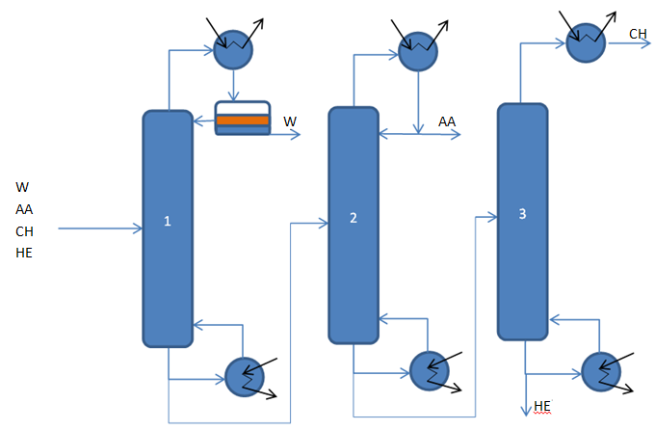
Step 1: Rebuild and simulate the conventional arrangement
Conventional arrangement
AA is Acetic Acid, CH is Cyclohexanone, W is Water and HE is Heavy Organics

Slide 5
Step 1: Rebuild and simulate the conventional arrangement
VAPOR LIQUID EQUILIBRIUM ANALYSIS
NRTL-HOC is chosen as thermodynamic model for the given system
 | Cyclohexanone₁-acetic acid₂ | Acetic acid₁-water₂ | Cyclohexanone₁-water₂
Origin | Regression to data | Regression to data | Regression to data
B₁₂ | 1715.54 | 255.44 | -164.59
B₂₁ | 113.07 | 19.412 | 1568.59
Α | 1.267 | 0.3 | 0.2
Equilibrium data for the ternary system cyclohexanone- acetic acid- water were carried out in Perstorp
Caprolactone and heavies activities are predicted in UNIFAC

Slide 6
Step 1: Rebuild and simulate the conventional arrangement
VLE of Water/acetic Acid system

Slide 7
Step 1: Rebuild and simulate the conventional arrangement
VLE of Water/Cyclohexanone system

Slide 8
Step 1: Rebuild and simulate the conventional arrangement

Slide 9
Step 2: Optimization of the conventional arrangement
AZEOTROPIC COLUMN
Operation condition: Feed entering into the stage 25.
Total number of stage is 50.
The feed stage is fixed ratio of the total number of stage (0.5)

Slide 10
Step 2: Optimization of the conventional arrangement
1/ Feed stage :
Stage No 25

Slide 11
Step 2: Optimization of the conventional arrangement
2/ Total number of stage :
The feed stage is fixed ratio of the total number of stage (0.5)
Total No of stage | FEED STAGE | TOT_REB
44 | 22 | 3147.464
45 | 22 | 3147.182
46 | 23 | 3146.942
47 | 23 | 3147.127
48 | 24 | 3147.106
50 | 25 | 3145.964
51 | 25 | 3145.966
53 | 27 | 3147.024
54 | 27 | 3146.999
“Optimum”

Slide 12
Step 2: Optimization of the conventional arrangement
3/ Water reflux ratio:
( 90% of water, 10% of Cyclohexanone):

Slide 13
Thank you for your attention

