Slide 1
Optimization of parameters in PID controllers
Ingrid Didriksen
Supervisors: Heinz Preisig and Erik Gran (Kongsberg)
Co-supervisor: Chriss Grimholt

Slide 2
Outline
Background
Objective
Process
Problem
Approach

Slide 3
Background
Engineering simulators
Simulated plant preform satisfactory
Control structure is applied to actual plant

Slide 4
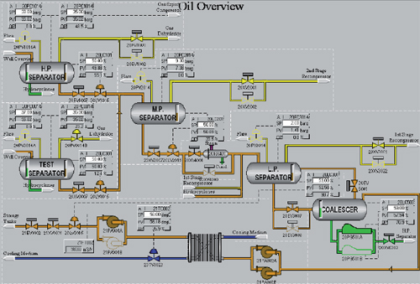
Mismatch between the simulated and observed performance
Update simulation
Many advantages

Slide 5
Design phase simulations have two stages
Steady state simulation
Dynamic simulation → optimizing transient behaviour
Transient behaviour
Change in production
Start up and shut down of process and utility systems
Mass and heat balance

Slide 6
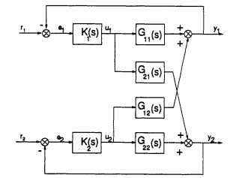
Background: Multivariable control
Practical control problems: a number of variables has to be controlled
PID controllers
Closing of one loop → affect dynamics of all the other loops

Slide 7
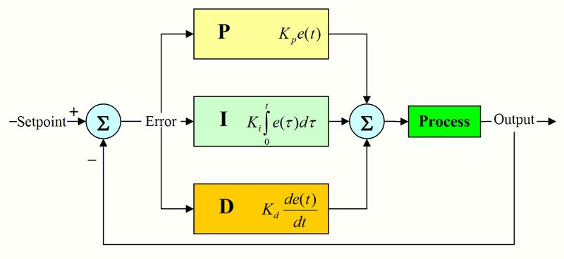
Objective
Method for calculating optimal parameters for PID controllers in a process plant
Implement method in Matlab
Model in K-Spice
Connect K-Spice to Matlab by an OPC interface
Kongsberg want to implement the method in K-Spice

Slide 8
Connection between K-Spice and Matlab
Simulation progam
OPC client
OPC server
Matlab

Slide 9
What?
Oil process
Consisting of
Four oil wells
Separation of oil, gas and water
Multivariable control problem

Slide 10
Problem
Set points changes
BUT the P, I and D parameters are set and not optimized later
Results in non optimal control
Never been tuned properly
Problem with interactions between control loops

Slide 11
Approach
The thesis is divided in two parts
A literature study on
- PID controller design
- Process identification
- Tuning methods
- Multivariable control tuning

Slide 12
Approach
2. An implementation of different methods in K-Spice
Implementing the tuning methods in K-Spice
Goal: Algorithm that can tune PID controllers for different set points

Slide 13
How?
Process model identification
PID controllers tuned one by one
Look at interactions between the loops

Slide 14
So far
Closed-loop process identification methods
Decentralized control methods
Connected K-Spice to Matlab by use of an OPC interface
Opc toolbox in Matlab

Slide 15
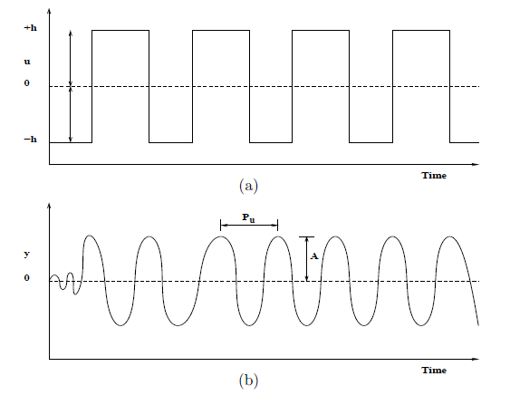
Identification method: Relay feedback

Slide 16
Advantages: relay feedback
auto tuning method
does not require much information about the process

Slide 17
Relay feedback identification algorithm in Matlab
Similar results to Skogestad’s half rule
Used SIMC rules
Next step: use this on the process in K-Spice

Slide 18
Decentralized control
Independent feedback controllers
Diagonal feedback control

Slide 19
Decentralized control methods
Luyben’s biggest log modulus tuning method
Autotuning of multiloop PI controllers by using relay feedback (Loh et al. 1993)
Decentralized PI control system based on Nyquist stability analysis (Chan and Seborg, 2002)
Open for suggestions

Slide 20
Further work
Read up on other identification methods
Learn more about K-Spice
Start tuning controllers in K-Spice
Implement multivariable control methods
If time, seek performance optimization

Slide 21
Summary
Methods for calculating optimal parameters for PID controllers in a process plant
Why?
Better control for different set points
How?
Identify process model
Tune the controllers one by one
Multivariable control

Slide 22
Thank you for your attention!

