Slide 1

Control Structure Selection for a Methanol Plant using Hysys/Unisim
Adriana Reyes Lúa
Supervisor: Sigurd Skogestad
Co-supervisor: Vladimiros Minasidis
Master Project
Mid-Term Presentation
Spring 2014
Mid-term Presentation

Slide 2
Outline
Introduction
Previous work
  Specialization Project
Work in progress
Future work

Slide 3
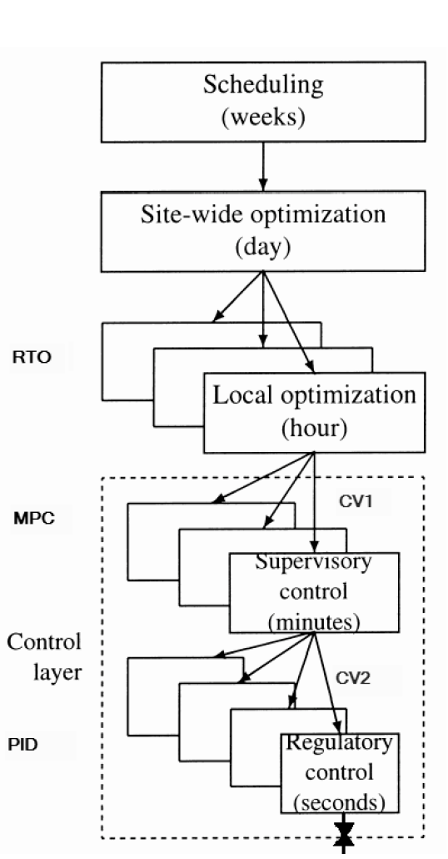
Plantwide Control
“Control structure design for complete chemical plants”
Systematic procedure for the design of an control structure, based on steady state plant economics.
  Top down
  Bottom up

Slide 4
Plantwide Control
1. Top-down
Step 1: Define operational objectives (economics) and constraints.
Step 2: Identify steady state degrees of freedom and determine steady state operation conditions.
Step 3: Identify candidate measurements y and select CV₁ =Hy
Step 4: Select the location of the throughput manipulator.

Slide 5
Plantwide Control:
The Challenge
To be accepted and used in industry, the procedure:
  must result in processes with near optimal operation.
  should not employ complex control technology.
  simple to apply.
Proposed solution:
  self-optimizing control.
  automate procedure and hide complexities.
  Can this be done using process simulators?
Intuitive.
Widely used.
Pre-loaded information.
Design mode vs. operation mode.
Poor numerical properties.
Not standardized.

Slide 6
Objective
To investigate if commercial process simulators could be effectively used for the automation of the plantwide control procedure.

Slide 7
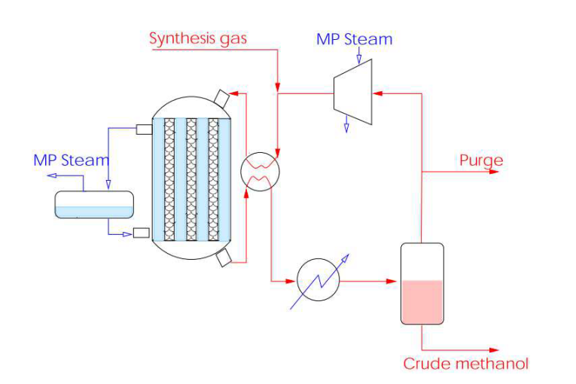
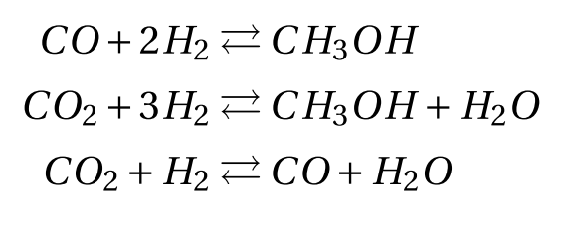
Case Study: Methanol Plant
First of all, you need a model!
Reactor, a separator, and a recycle stream with purge.
Scheme of a methanol plant (Løvik,2001)

Slide 8
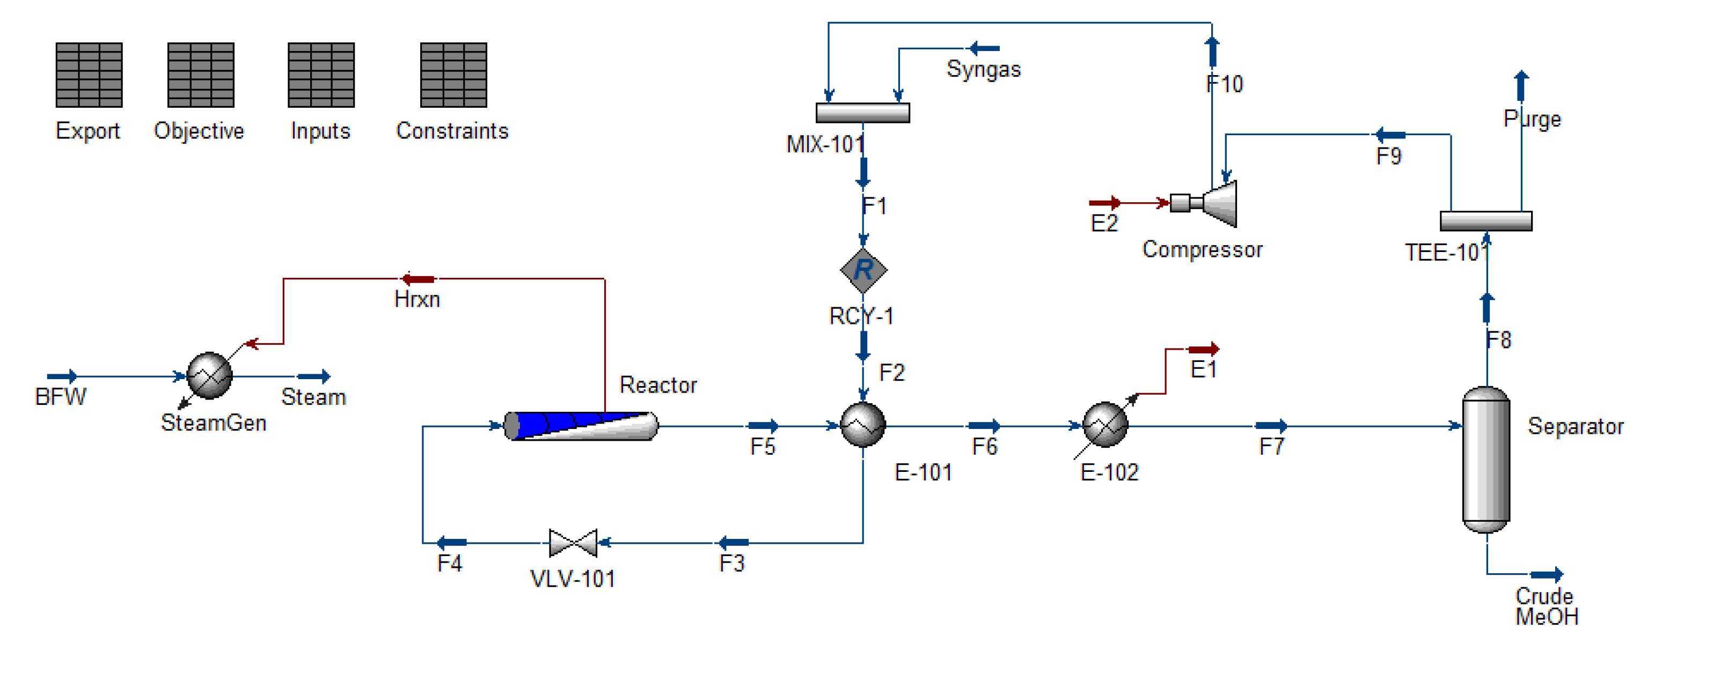
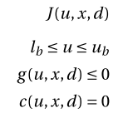
The Model
The “operation mode” process simulation is the model.
When using this type of model:
The interactions among the variables are not explicit.
We do not have equations to describe our model.

Slide 9
Plantwide Procedure: Step 1
Define:
Operational objectives (economics) and constraints.
Objective function for specialization project:
Reviewed objective function:
The purge is now treated as a product.
The costs of the purge and electricity were also reviewed.

Slide 10

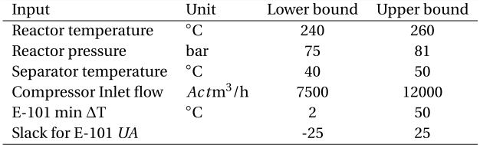
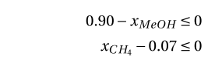

Plantwide Procedure: Step 1

Slide 11
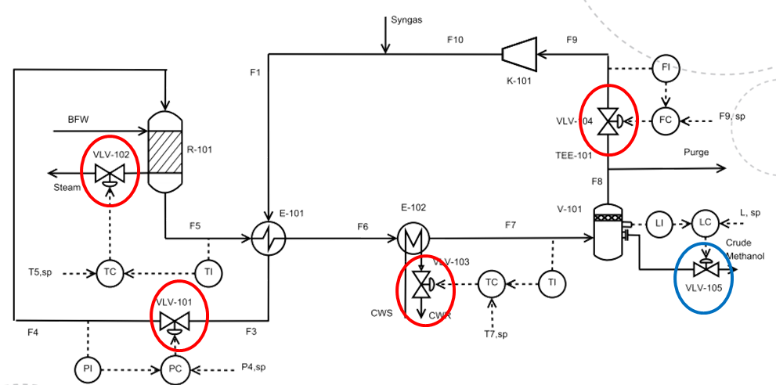
Plantwide Procedure: Step 2
Identify steady state degrees of freedom.

Slide 12
Plantwide Procedure: Step 2
Identify steady state degrees of freedom.
4 steady state degrees of freedom.
Identify important disturbances.
Determine steady state operation conditions.
→ You need to optimize!

Slide 13
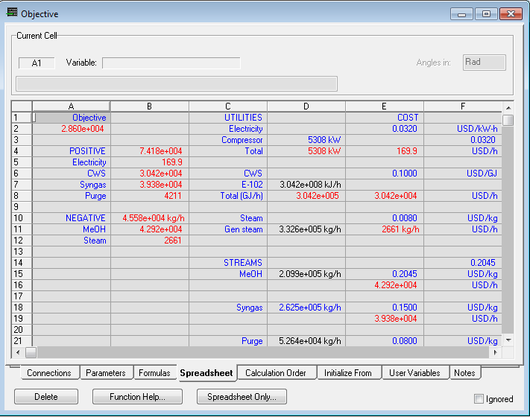
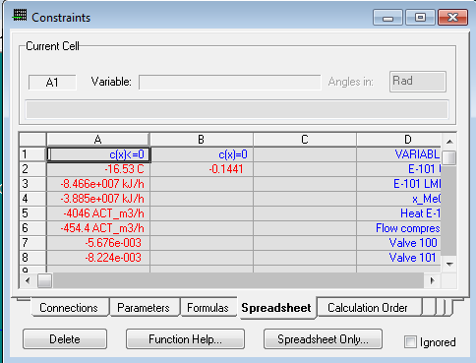
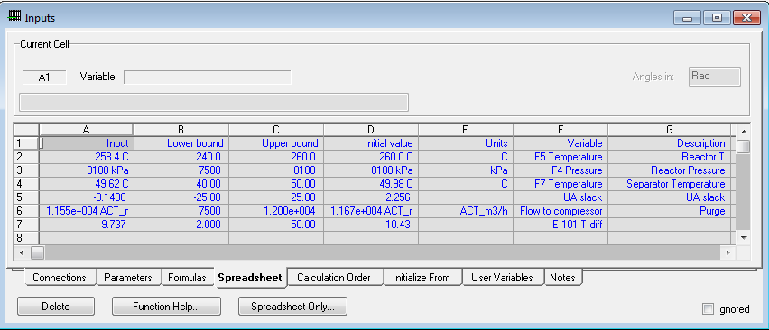
Optimizing the Simulation
As done for the
Specialization Project
COM
Matlab
UniSim
NLP Solver
  fmincon
  Interior point
  (satisfies bounds)
NLP Model
NLP model independent of NLP solver.

Slide 14
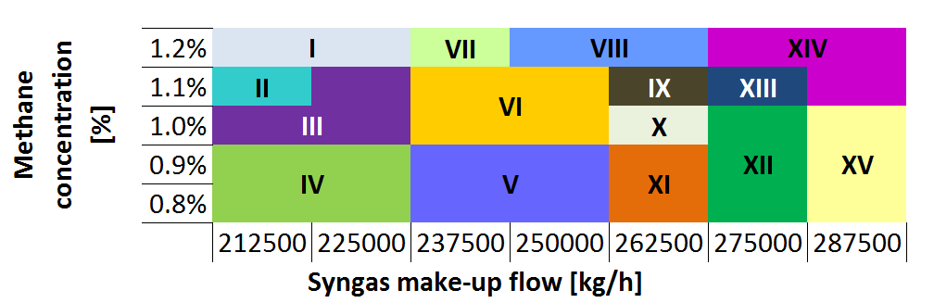
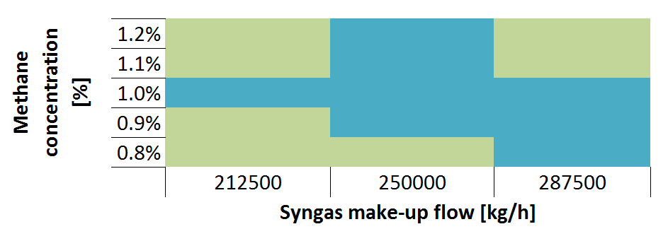
Plantwide Procedure: Step 2
Purge treated as waste (you pay for purging).
Purge treated as product.
Pressure (l), temperature (h), flow to compressor (l)
Pressure (l), temperature (h), flow to compressor (l),
UA slack (h)

Slide 15
Plantwide Procedure: Step 2
Pressure (l), temperature (h), flow to compressor (l)
Pressure (l), temperature (h), flow to compressor (l),
UA slack (h)
Noisy model
Crude area approximation
Control structure for a single point.
→ step size issues.
→ finer grid.
→ single region-wide control structure.

Slide 16
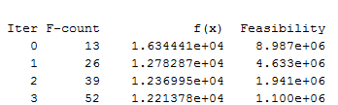

Gradient-based approach to solve the problem:
For each iteration step it does 2*n+1 function evaluations.
Each iteration is expensive.
Dependant on step size.
Each function evaluation means running the simulation.
  For the case study (6 variables), at least abt. 300 function evaluations are required.
→ You want to reduce the number of function evaluations!

Slide 17
Derivative-free optimization
Objective function values available.
  F is a “black box” that returns the value F(x) for any feasible x.
Derivative information: unavailable, unreliable, unpractical.
  The function is expensive to evaluate or noisy.
  Some algorithms can handle bounds a ≤ x ≤ b
→ Same characteristics as our model.

Slide 18
Derivative-free optimization
Classification of algorithms:
  Direct: search direction defined by computing values of the function directly.
  Model based: construct a surrogate model of the function to guide the search process.
  Local/Global: search domain definition.
  Stochastic/Deterministic: random search steps or not.

Slide 19
Derivative-free trust- region methods
Surrogate and easy to evaluate model.
  Obtained by interpolation.
Basic idea:
  Define a region in which the model is an adequate representation of the objective function.
  Choose the step (direction and length) to be the approximate minimizer of the model in this region.

Slide 20
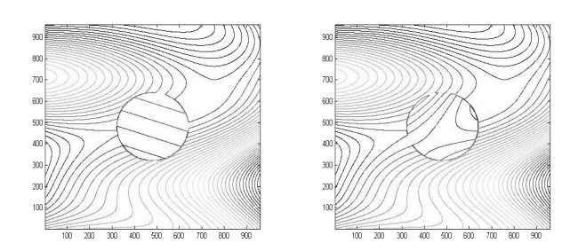
Trust- region methods
Contours of a nonlinear function in a trust region.
linear model quadratic model
Conn, Andrew R., Scheinberg, Katya, Vicente, Luis N. Introduction to Derivative-Free Optimization, 2009

Slide 21
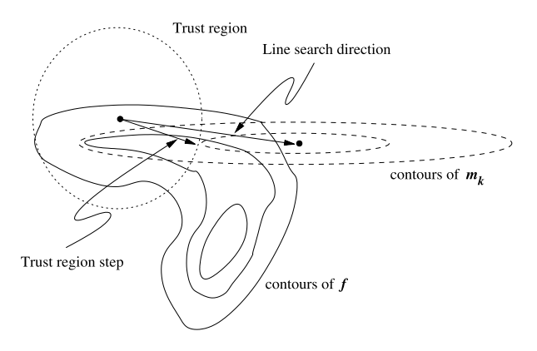
Trust- region algorithm
0. Initialize
Solve trust region problem:
calculate step
Acceptance of step.
Update model.
Update trust region.
Stopping criterion
Quadratic model
Real function
Taylor approximation

Slide 22
Derivative-free trust- region algorithm
The objective function is approximated by quadratic models obtained by a 2nd order Taylor approximation.
Solves bound constrained optimization problems.
  Considers bounds when calculating the trust region step.
  Obtains an approximate solution for the approximation m_{k} (x_{k} + s)
  The solution is in the intersection of the trust-region with the bound constraints.

Slide 23
Derivative-free trust- region algorithm
Derivative-free trust-region algorithm.
The objective function is approximated by quadratic models obtained by a 2nd order Taylor approximation.
Solves bound constrained optimization problems.
The number of interpolation points can vary.
In each iteration, only one interpolation point is replaced
  The objective function is evaluated once per iteration.

Slide 24
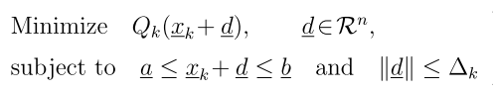
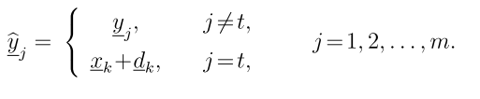
Derivative-free trust- region algorithm
Initialize: generate interpolation points and model.
Solve quadratic trust-region problem.
Acceptance test for the step.
  Update trust-region radius
Alternative iteration
  Re-calculate s in order to improve the geometry of the interpolation set.
Update interpolation set and quadratic model.
Stopping criterion.

Slide 25
Work to do
Finish programming the DFO algorithm.
Obtain more detailed active constraint regions.
Find control structures for the identified regions.
Investigate the posibility of finding a region-wide control structure.

Slide 26
Thank you for your attention!

Slide 27





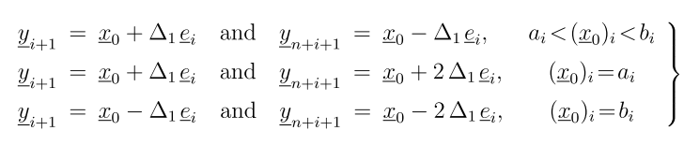
Quadratic approximation
At each iteration:
Trust region:
Interpolation points:

Slide 28

Derivative-free trust- region algorithm
Uses quadratic model.
  Independent coefficients:
The number of interpolation conditions can vary.
Remaining degrees of freedom are calculated minimizing the Frobenius norm of the difference of two consecutive Hessian models.
The Frobenius norm is strictly convex.

Slide 29
Derivative-free trust- region algorithm
Linear independence on the interpolation condition is maintained.
The trust-region quadratic minimization subproblem is solved using a truncated conjugate gradient method.
Updates:
  If the trust-region minimization produces an acceptable step the function f is evaluated at x_{k} + s and this new point becomes the next iterate, x_{k+1},
  If the step is not accepted, use “alternative iteration”.
  The model can also be updated.

Slide 30
Derivative-free trust- region algorithm
Initialize: generate interpolation points and model.
Solve quadratic trust-region problem.
Acceptance test for the step.
  Update trust-region radius
Alternative iteration
  Re-calculate s in order to improve the geometry of the interpolation set.
Update interpolation set and quadratic model.
Stopping criterion.

