Slide 1
Operation and Control of Divided Wall (Petlyuk) Column
Speaker : Ambari Khanam
Course : Master Thesis
Department of Chemical Engineering
Project-Supervisor : Sigurd Skogestad

Slide 2
Outline
Introduction to Divided Wall Column (DWC)
  Need and challenges
The Thesis work.
- Investigation of all possible modes of operation for DWC
- Self-optimizing control scheme for maximizing the product recovery
Work done so far
Remaining work

Slide 3
Why DWC?
Capital and energy saving (30%)
Space saving (30%)
Low green house gas emission
Can deal with energy crisis scenario
Thermal stress reduced

Slide 4
Challenges
Reliable design
Operation and Control
Only one pressure range possible
Higher column height

Slide 5
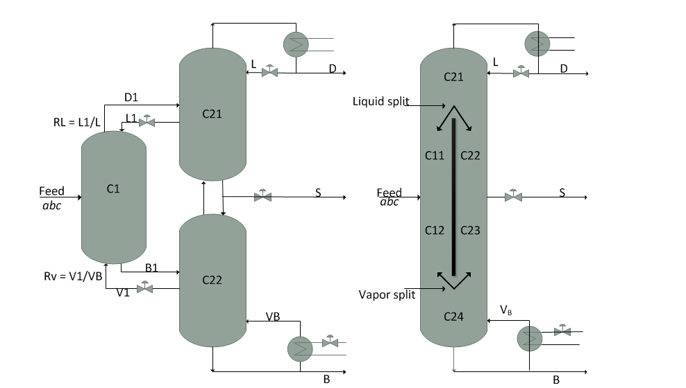
Divided Wall Column
(a) Implementation with three separate columns (b) DWC implementation with a side-product
Figure. Thermodynamically equivalent implementations of three-product Petlyuk column
Notes:
Discuss degree of freedom, wall,

Slide 6
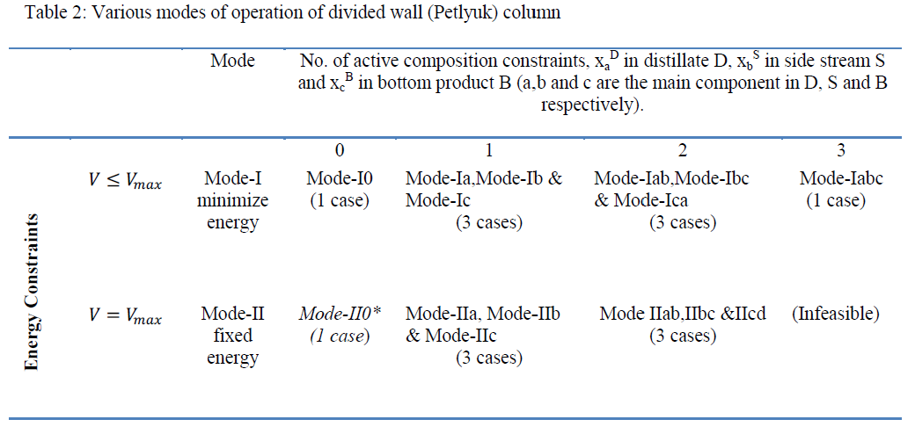
Modes of Operation

Slide 7

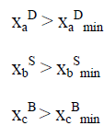

Optimization
Objective function:
Minimize the sum of impurities

Slide 8
Thesis Work:
Little modification in the Petlyuk model
Finding optimal solution
Finding candidates for self-optimizing CV’s
4. Implementation of feedback control.
Notes:
1. problem, should there be p control, should I start with initial

Slide 9
Self-optimizing variables
Implementing disturbance and re-optimize
Loss evaluation
work on control structures

Slide 10
Work done so far
Model improvement
Verification and results retrieved for previous work
Optimization
Temperature calculation

Slide 11
Remaining Tasks
Selection of measurement for CVs
[T1,T2,T3......................T120,L,S,Vmax]
Find a suitable method for the evaluation of loss
Feedback control for selected CVs using SIMC.

Slide 12
ANY question?
Your feedback is welcome

